Slide 1



LIFE/work balance
We have started a #LIFEworkbalance campaign and we need your help to complete our LIFE/work balance survey.
We hope to publish the results soon, so please give 15 minutes of your time to help us get a true picture of school life.
Want to be a part of this campaign? Take the survey on our website and share it with your colleagues!
© Classroom Secrets Limited 2019

Slide 2
Year 2 – Autumn Block 2 – Addition and Subtraction – 10 More and 10 Less
About This Resource:
This PowerPoint has been designed to support your teaching of this small step. It includes a starter activity and an example of each question from the Varied Fluency and Reasoning and Problem Solving resources also provided in this pack. You can choose to work through all examples provided or a selection of them depending on the needs of your class.
National Curriculum Objectives:
Mathematics Year 2: (2C1) Recall and use addition and subtraction facts to 20 fluently, and derive and use related facts up to 100
More Year 2 Addition and Subtraction resources.
Did you like this resource? Don’t forget to review it on our website.
© Classroom Secrets Limited 2018

Slide 3
Year 2 – Autumn Block 2 – Addition and Subtraction
Step 7: 10 More and 10 Less
© Classroom Secrets Limited 2018

Slide 4
Introduction
Look at the highlighted number sequence.
Can you explain the pattern?
1 | 2 | 3 | 4 | 5 | 6 | 7 | 8 | 9 | 10
11 | 12 | 13 | 14 | 15 | 16 | 17 | 18 | 19 | 20
21 | 22 | 23 | 24 | 25 | 26 | 27 | 28 | 29 | 30
31 | 32 | 33 | 34 | 35 | 36 | 37 | 38 | 39 | 40
41 | 42 | 43 | 44 | 45 | 46 | 47 | 48 | 49 | 50
51 | 52 | 53 | 54 | 55 | 56 | 57 | 58 | 59 | 60
61 | 62 | 63 | 64 | 65 | 66 | 67 | 68 | 69 | 70
71 | 72 | 73 | 74 | 75 | 76 | 77 | 78 | 79 | 80
81 | 82 | 83 | 84 | 85 | 86 | 87 | 88 | 89 | 90
91 | 92 | 93 | 94 | 95 | 96 | 97 | 98 | 99 | 100
© Classroom Secrets Limited 2018

Slide 5
Introduction
Look at the highlighted number sequence.
Can you explain the pattern?
The tens are increasing by 1 each time and the
ones remain the same.
1 | 2 | 3 | 4 | 5 | 6 | 7 | 8 | 9 | 10
11 | 12 | 13 | 14 | 15 | 16 | 17 | 18 | 19 | 20
21 | 22 | 23 | 24 | 25 | 26 | 27 | 28 | 29 | 30
31 | 32 | 33 | 34 | 35 | 36 | 37 | 38 | 39 | 40
41 | 42 | 43 | 44 | 45 | 46 | 47 | 48 | 49 | 50
51 | 52 | 53 | 54 | 55 | 56 | 57 | 58 | 59 | 60
61 | 62 | 63 | 64 | 65 | 66 | 67 | 68 | 69 | 70
71 | 72 | 73 | 74 | 75 | 76 | 77 | 78 | 79 | 80
81 | 82 | 83 | 84 | 85 | 86 | 87 | 88 | 89 | 90
91 | 92 | 93 | 94 | 95 | 96 | 97 | 98 | 99 | 100
© Classroom Secrets Limited 2018

Slide 6

Varied Fluency 1
What is 10 less than the number shown below?
© Classroom Secrets Limited 2018

Slide 7
Varied Fluency 1
What is 10 less than the number shown below?
58
© Classroom Secrets Limited 2018

Slide 8
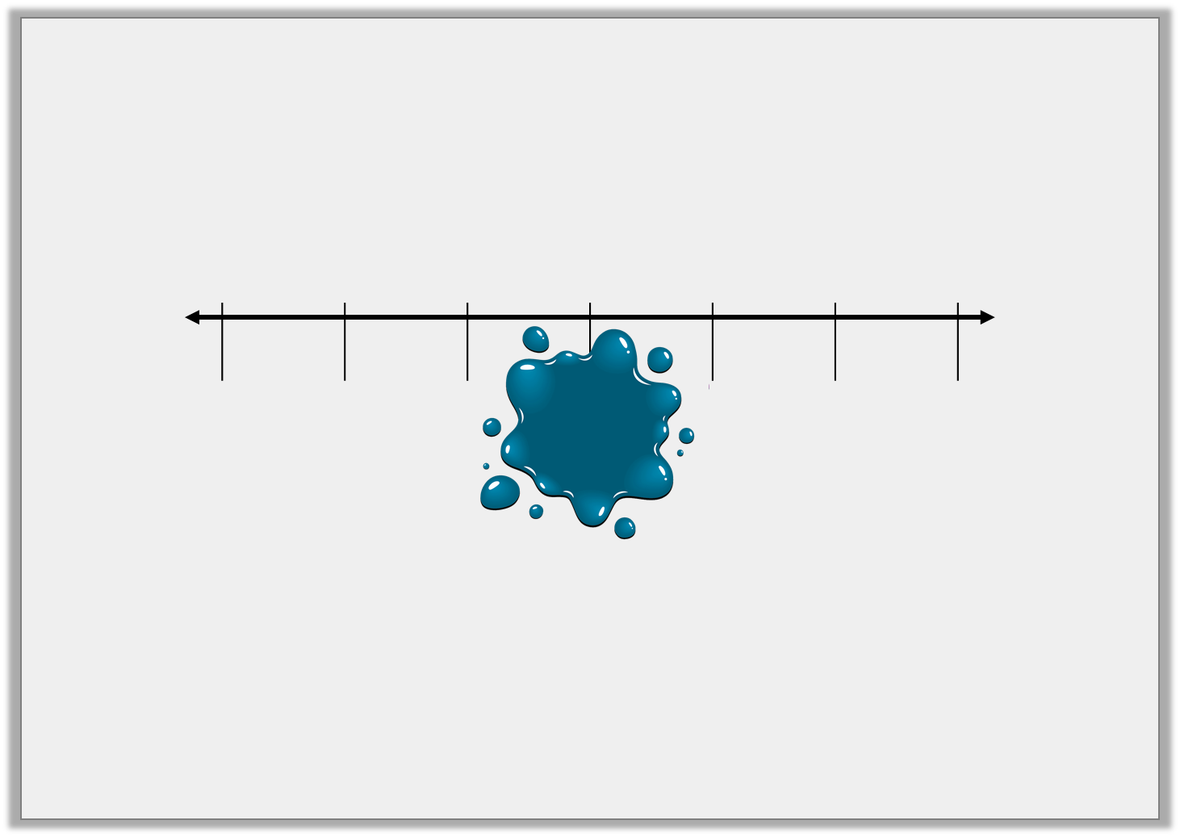
Varied Fluency 2
What is the missing number?
23 | 33 | 43 |  | 63 | 73 | 83
© Classroom Secrets Limited 2018

Slide 9
Varied Fluency 2
What is the missing number?
23 | 33 | 43 | 53 | 63 | 73 | 83
© Classroom Secrets Limited 2018

Slide 10
Varied Fluency 3
Find the missing numbers.
37
10 more
A
66
10
less
B
89
10
less
C
71
10 more
D
© Classroom Secrets Limited 2018

Slide 11
Varied Fluency 3
Find the missing numbers.
37
10 more
47
66
10
less
56
89
10
less
79
71
10 more
81
© Classroom Secrets Limited 2018

Slide 12
Varied Fluency 4
What numbers are missing from the number grid?
87 | 77 | 67 | 57 | 47
86 | 76 | 66 | 56 | 46
84 | 74 | 64 | 54 | 44
© Classroom Secrets Limited 2018

Slide 13
Varied Fluency 4
What numbers are missing from the number grid?
87 | 77 | 67 | 57 | 47
86 | 76 | 66 | 56 | 46
85 | 75 | 65 | 55 | 45
84 | 74 | 64 | 54 | 44
© Classroom Secrets Limited 2018

Slide 14
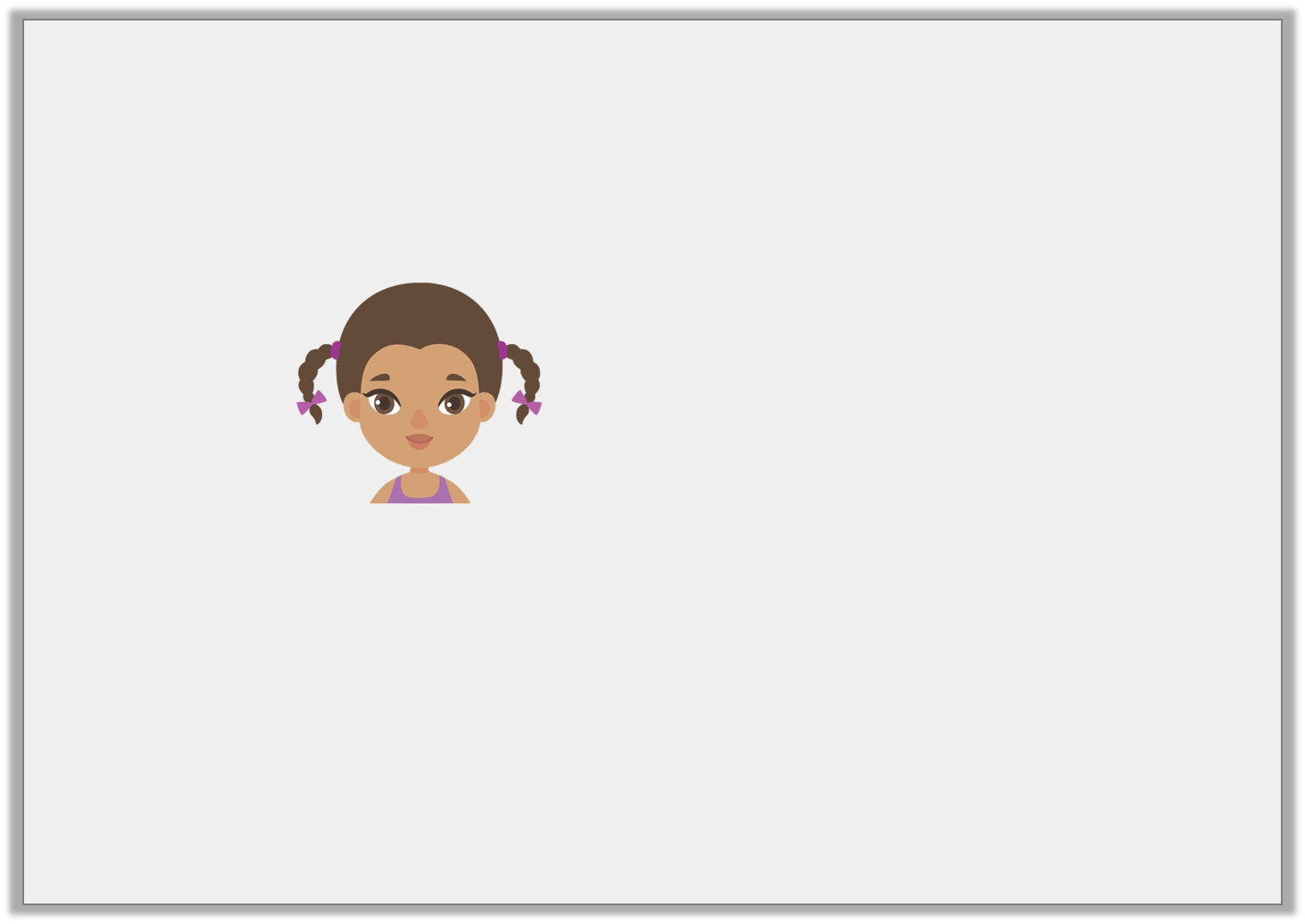
Reasoning 1
Is Maddie correct? Explain your answer.
My hair is 42cm long. If it grows 10cm more, it will be 52cm long.
© Classroom Secrets Limited 2018

Slide 15
Reasoning 1
Is Maddie correct? Explain your answer.
Maddie is correct because…
My hair is 42cm long. If it grows 10cm more, it will be 52cm long.
© Classroom Secrets Limited 2018

Slide 16
Reasoning 1
Is Maddie correct? Explain your answer.
Maddie is correct because 10 more than 42 is 52. The tens column has increased by 1 and then ones have stayed the same.
My hair is 42cm long. If it grows 10cm more, it will be 52cm long.
© Classroom Secrets Limited 2018

Slide 17
Reasoning 2
Elliot has created a sequence of numbers.
Is he correct? Explain your answer.
16 | 26 | 46 | 56
10
1
10
1
10
1
10
1
1
10
1
10
1
10
1
1
1
10
1
10
1
1
1
10
1
10
1
1
1
1
10
1
1
1
1
1
© Classroom Secrets Limited 2018

Slide 18
Reasoning 2
Elliot has created a sequence of numbers.
Is he correct? Explain your answer.
Elliot is not correct because . . .
16 | 26 | 46 | 56
10
1
10
1
10
1
10
1
1
10
1
10
1
10
1
1
1
10
1
10
1
1
1
10
1
10
1
1
1
1
10
1
1
1
1
1
© Classroom Secrets Limited 2018

Slide 19
Reasoning 2
Elliot has created a sequence of numbers.
Is he correct? Explain your answer.
Elliot is not correct because 10 more than 26 is 36.
The sequence should be: 16, 26, 36, 46, 56
16 | 26 | 46 | 56
10
1
10
1
10
1
10
1
1
10
1
10
1
10
1
1
1
10
1
10
1
1
1
10
1
10
1
1
1
1
10
1
1
1
1
1
© Classroom Secrets Limited 2018

Slide 20
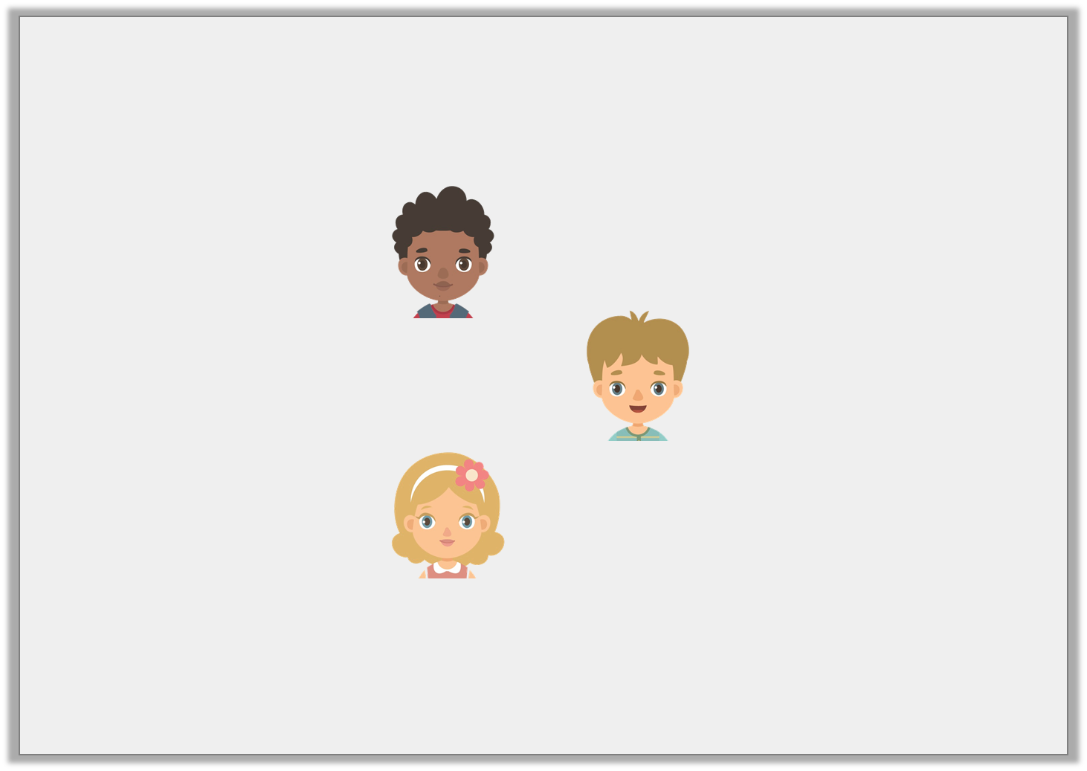
Problem Solving 1
Each child has chosen a number.
Which number has not been chosen?
My number is 10 less than 64.
My number is 10 more than 54.
My number is 10 less than 63.
73
54
53
64
© Classroom Secrets Limited 2018

Slide 21
Problem Solving 1
Each child has chosen a number.
Which number has not been chosen?
My number is 10 less than 64.
My number is 10 more than 54.
My number is 10 less than 63.
73
54
53
64
© Classroom Secrets Limited 2018

