Slide 1



LIFE/work balance
We have started a #LIFEworkbalance campaign and we need your help to complete our LIFE/work balance survey.
We hope to publish the results soon, so please give 15 minutes of your time to help us get a true picture of school life.
Want to be a part of this campaign? Take the survey on our website and share it with your colleagues!
© Classroom Secrets Limited 2019

Slide 2
Year 2 – Autumn Block 1 – Place Value – Count in 2s, 5s, 10s
About This Resource:
This PowerPoint has been designed to support your teaching of this small step. It includes a starter activity and an example of each question from the Varied Fluency and Reasoning and Problem Solving resources also provided in this pack. You can choose to work through all examples provided or a selection of them depending on the needs of your class.
National Curriculum Objectives:
Mathematics Year 2: (2N1) Count in steps of 2, 3 and 5, from 0, and in tens from any number, forward or backward
More Year 2 Place Value resources.
Did you like this resource? Don’t forget to review it on our website.
© Classroom Secrets Limited 2018

Slide 3
Year 2 – Autumn Block 1 – Place Value
Step 9: Count in 2s, 5s, 10s
© Classroom Secrets Limited 2018

Slide 4
Introduction
True or false? These numbers are counting up in ascending order.
58 | 51 | 45 | 39 | 35 | 30 | 27 | 18 | 3
© Classroom Secrets Limited 2018

Slide 5
Introduction
True or false? These numbers are counting up in ascending order.
False.
The numbers are getting smaller and are in descending order.
58 | 51 | 45 | 39 | 35 | 30 | 27 | 18 | 3
largest | smallest
© Classroom Secrets Limited 2018

Slide 6
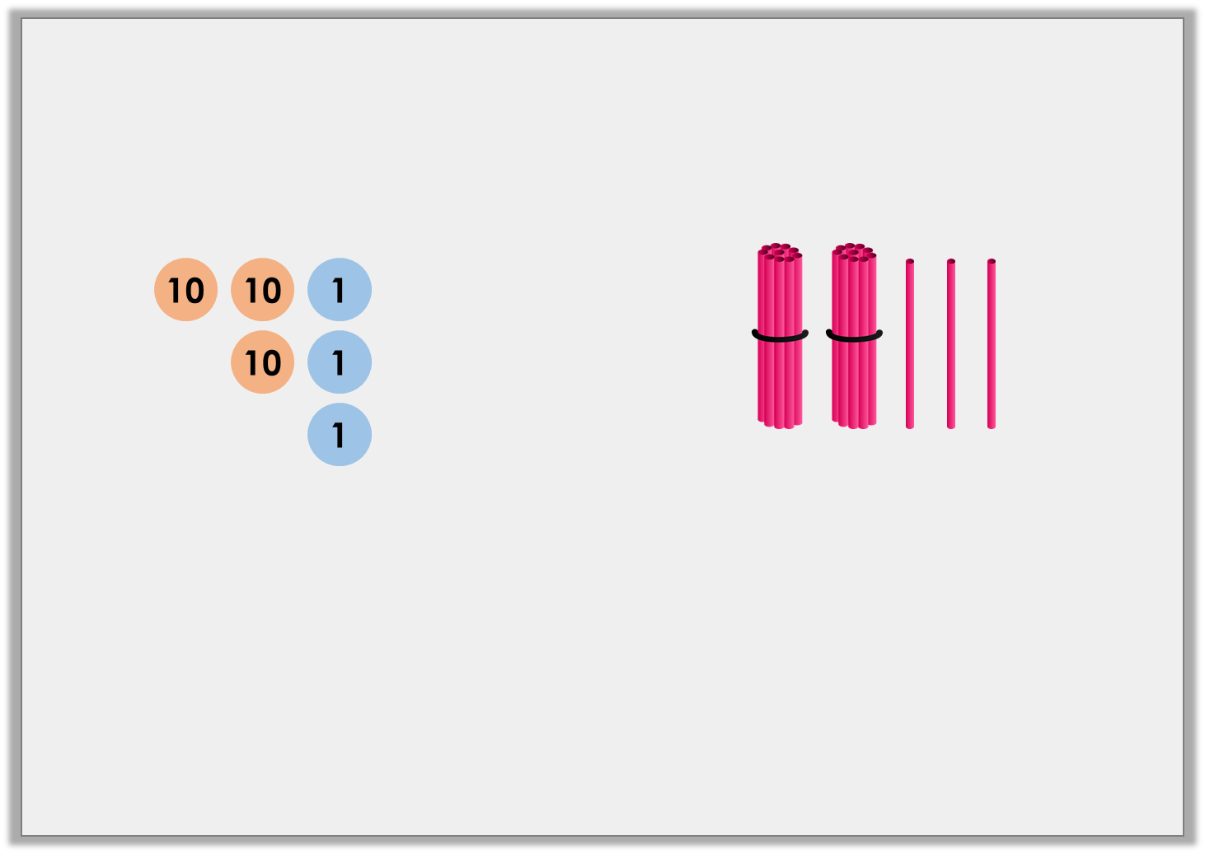
Varied Fluency 1
Circle the number you would not say if you counted backwards in 10s from 63.
A. | B.
C. | D. | E.
53 | seventy + three | 3
© Classroom Secrets Limited 2018

Slide 7
Varied Fluency 1
Circle the number you would not say if you counted backwards in 10s from 63.
A. | B.
C. | D. | E.
53 | seventy + three | 3
© Classroom Secrets Limited 2018

Slide 8
Varied Fluency 2
True or false? This sequence of numbers increases by 2 each time.
32, 34, 36, 38, 40
© Classroom Secrets Limited 2018

Slide 9
Varied Fluency 2
True or false? This sequence of numbers increases by 2 each time.
32, 34, 36, 38, 40
True
© Classroom Secrets Limited 2018

Slide 10
Varied Fluency 3
Fill in the blanks of the number sequence below.
65 | 60 |  | 50 | 45 |  | 35
© Classroom Secrets Limited 2018

Slide 11
Varied Fluency 3
Fill in the blanks of the number sequence below.
65 | 60 | 55 | 50 | 45 | 40 | 35
© Classroom Secrets Limited 2018

Slide 12
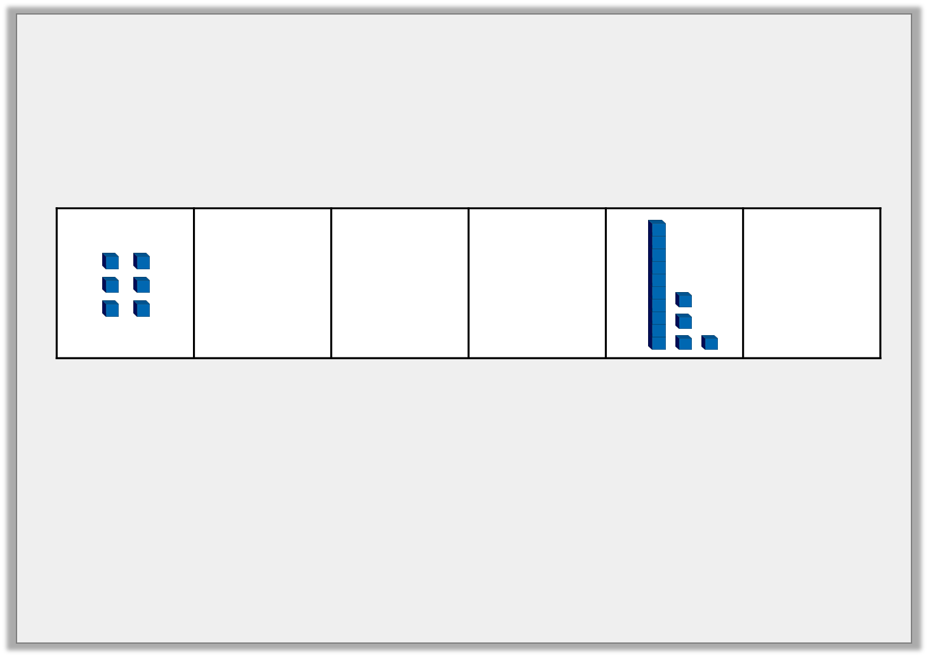
Varied Fluency 4
Which statement describes the number sequence?
It is counting up in 10s.
It is counting up in 2s.
It is counting up in 5s.
 | 8 | ten | twelve |  | 16
© Classroom Secrets Limited 2018

Slide 13
Varied Fluency 4
Which statement describes the number sequence?
It is counting up in 10s.
It is counting up in 2s.
It is counting up in 5s.
 | 8 | ten | twelve |  | 16
© Classroom Secrets Limited 2018

Slide 14
Problem Solving 1
Find your way through the maze by counting backwards through multiples of 2.
82 | 80 | 85 | 80
13 | 78 | 21 | 100
91 | 76 | 25 | 11
33 | 74 | 72 | 70
Start
Finish
© Classroom Secrets Limited 2018

Slide 15
Problem Solving 1
Find your way through the maze by counting backwards through multiples of 2.
82 | 80 | 85 | 80
13 | 78 | 21 | 100
91 | 76 | 25 | 11
33 | 74 | 72 | 70
Start
Finish
© Classroom Secrets Limited 2018

Slide 16
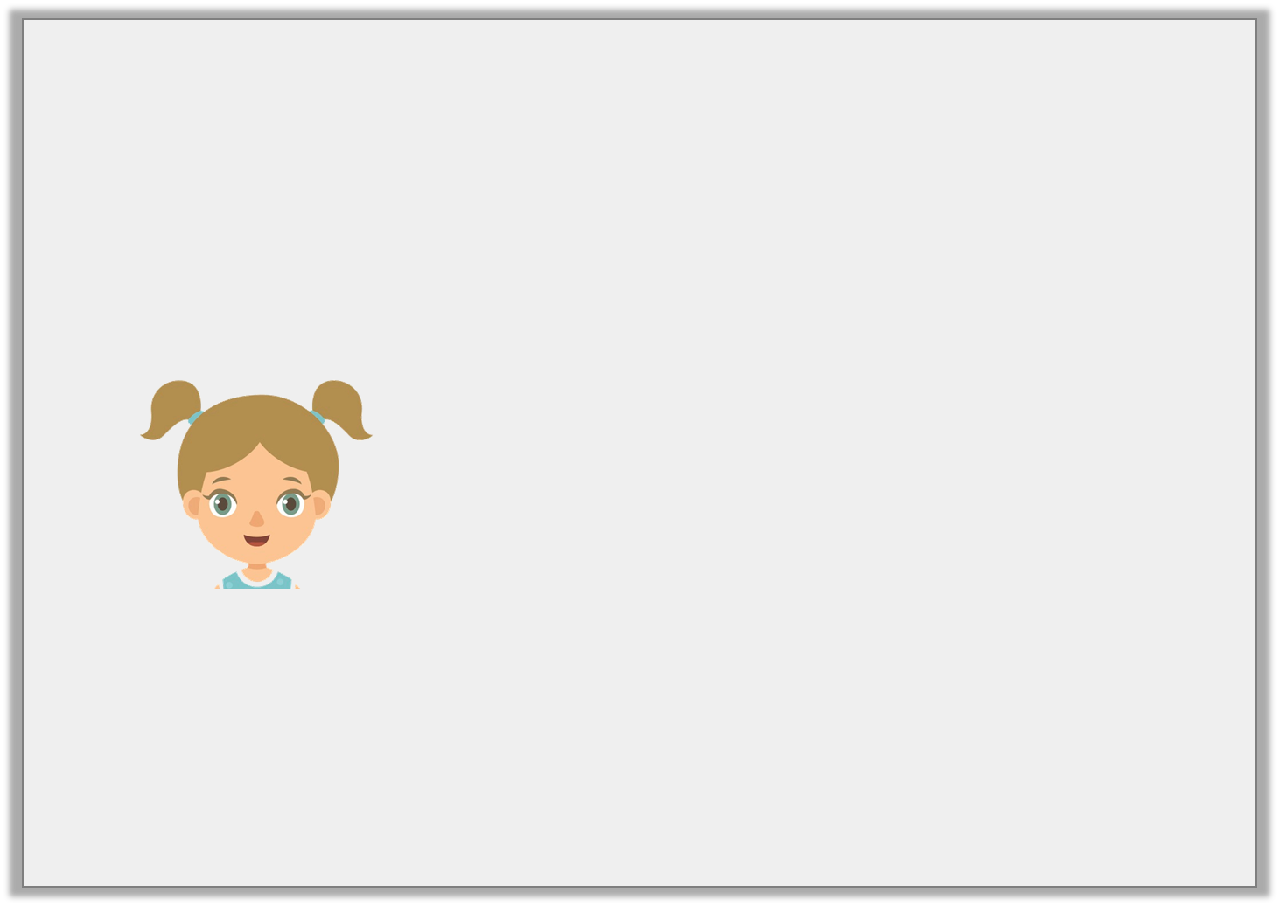
Reasoning 1
Zara is counting backwards in 10s.
Is she correct? Prove it.
If I start at 43, I will say 3.
© Classroom Secrets Limited 2018

Slide 17
Reasoning 1
Zara is counting backwards in 10s.
Is she correct? Prove it.
She is correct because…
If I start at 43, I will say 3.
© Classroom Secrets Limited 2018

Slide 18
Reasoning 1
Zara is counting backwards in 10s.
Is she correct? Prove it.
She is correct because 43 – 10 – 10 – 10 – 10 = 3
If I start at 43, I will say 3.
© Classroom Secrets Limited 2018

Slide 19

Reasoning 2
Rohan says the following numbers:
What number will he say next? Explain how you know.
45, 50, fifty-five, 60, 65, seventy
© Classroom Secrets Limited 2018

Slide 20
Reasoning 2
Rohan says the following numbers:
What number will he say next? Explain how you know.
He will say 75 because…
45, 50, fifty-five, 60, 65, seventy
© Classroom Secrets Limited 2018

Slide 21
Reasoning 2
Rohan says the following numbers:
What number will he say next? Explain how you know.
He will say 75 because he is counting forwards in 5s.
45, 50, fifty-five, 60, 65, seventy
© Classroom Secrets Limited 2018

