Slide 2
Aim
I can identify the benefits of the Internet and know how to look after my digital wellbeing.
Success Criteria
I can recognise that the Internet plays an increasingly big role in our daily lives.
I can identify the positive and negative uses of the Internet.
I can explain what digital wellbeing means and understand how to
look after my mental health and emotional wellbeing when I am online, including effectively managing my time.
I can think about steps I am going to take to have a healthy
digital life.
This resource is fully in line with the Learning Outcomes and Core Themes outlined in the PSHE Association’s Programme of Study.

Slide 3
The Big Questions

Slide 4

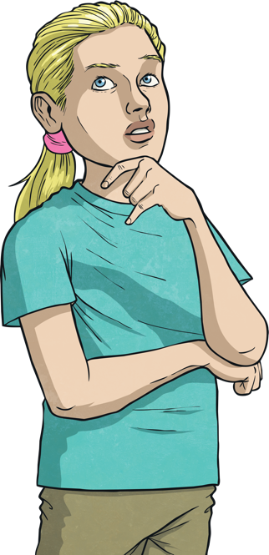
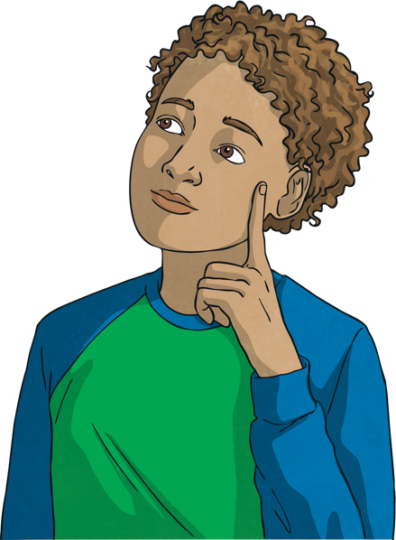
How can we look after our mental health and emotional wellbeing when
spending time online?
How can the Internet be used positively?
How can
it be used negatively?

Slide 5
Reconnecting

Slide 6


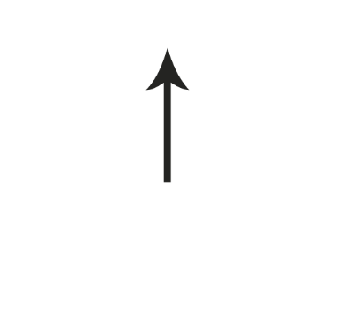

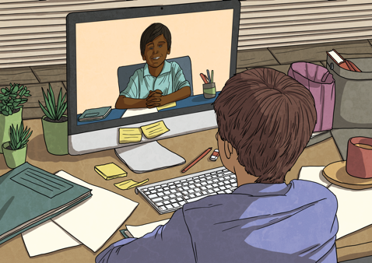
What Do We Use the
Internet For?
With a partner and in the time you are given, think of
as many different ways as you can that we use the Internet
in our daily lives.
Stop
The Internet is a growing part of our daily lives, that’s why it is important we learn how to use it in a way that helps us all and doesn’t harm anyone.
Your time is up! What different uses did you think of?

Slide 7
Exploring

Slide 8

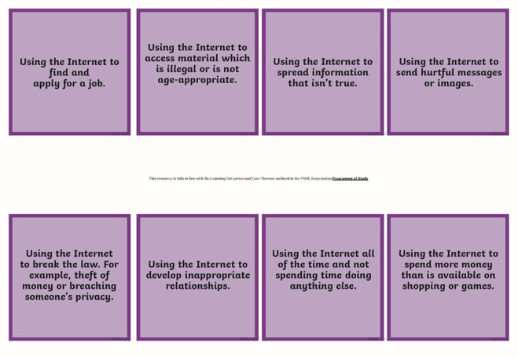
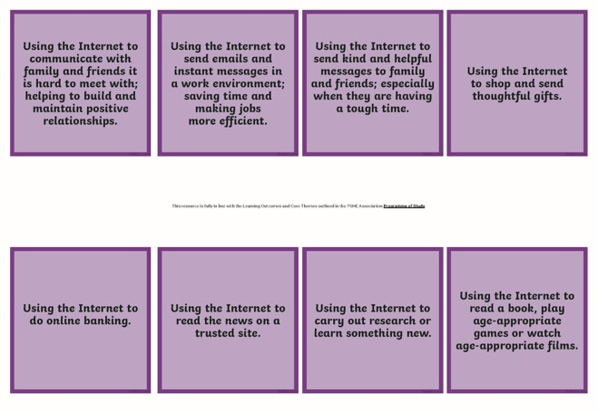
The Positive and Negative
Use of the Internet
Like many things in our lives, there are benefits of using the Internet
but there are also risks.
It is important we understand how the Internet can be used in a positive way but also in a negative way. This helps us all to stay safe and well.
With a parent, sort the cards into two groups. One group will show uses of the Internet you think are positive and the other group will show uses of the Internet you think are negative.

Slide 9

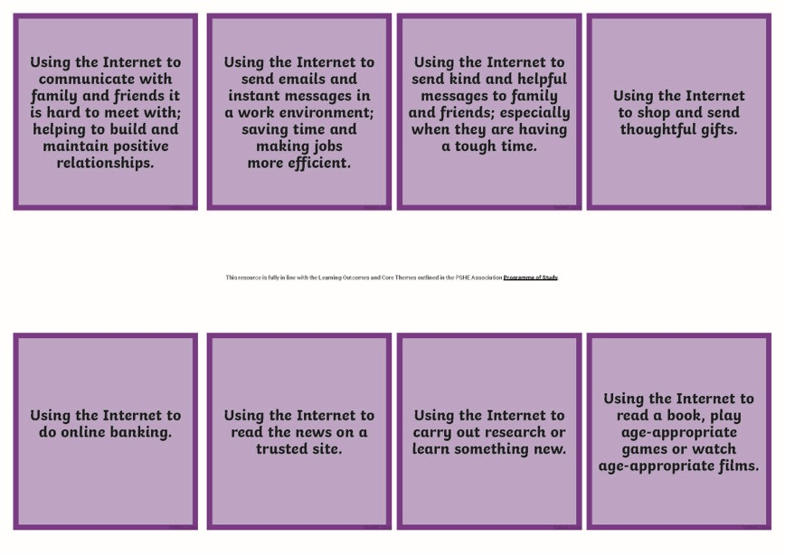
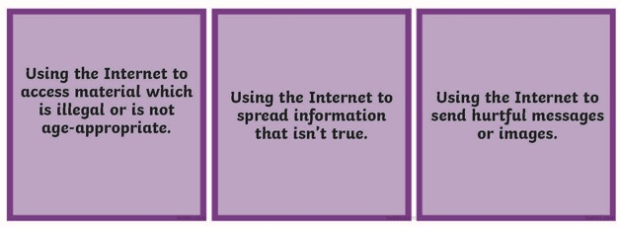
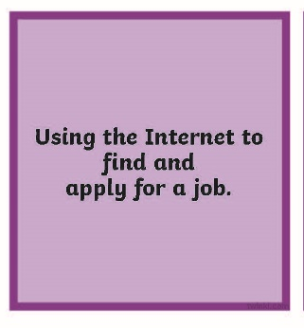
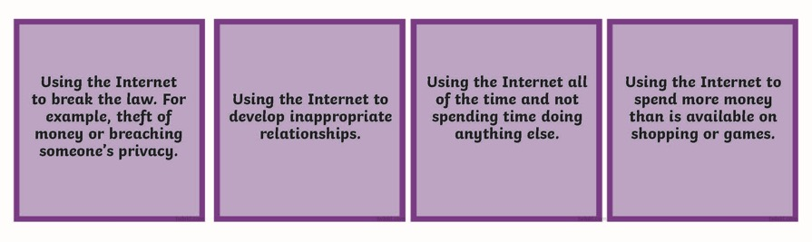
The Positive and Negative
Use of the Internet
How did you do?
These are some of the ways in which the Internet can be used positively…
These are some of the ways in which the Internet can be used negatively…
Were there any cards which you found hard to group? If so, why do you think that was?
We all have a shared responsibility to use the Internet positively, for our own wellbeing and the wellbeing of others.

Slide 10
Digital Wellbeing
Technology, and how we use it, can affect how each of us feel, think and behave. It can also affect the health of our body and mind. This is digital wellbeing.
It is important to understand how using digital technology, such as computers, tablets, phones and gaming devices, makes us feel so that we
can develop positive digital wellbeing.
Another part of digital wellbeing is knowing how to look after ourselves
and how to look after others online.
How do you think we can develop positive digital wellbeing?

Slide 11
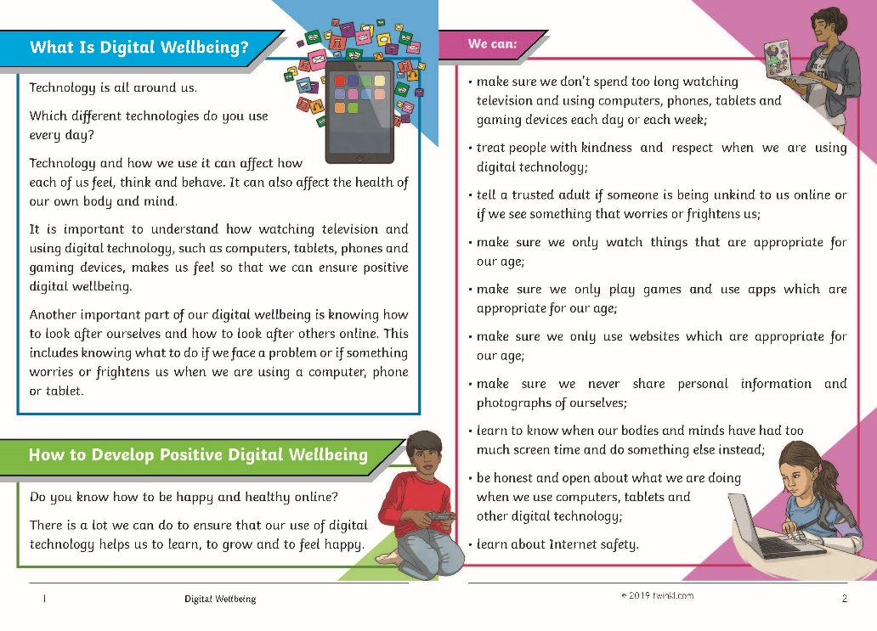
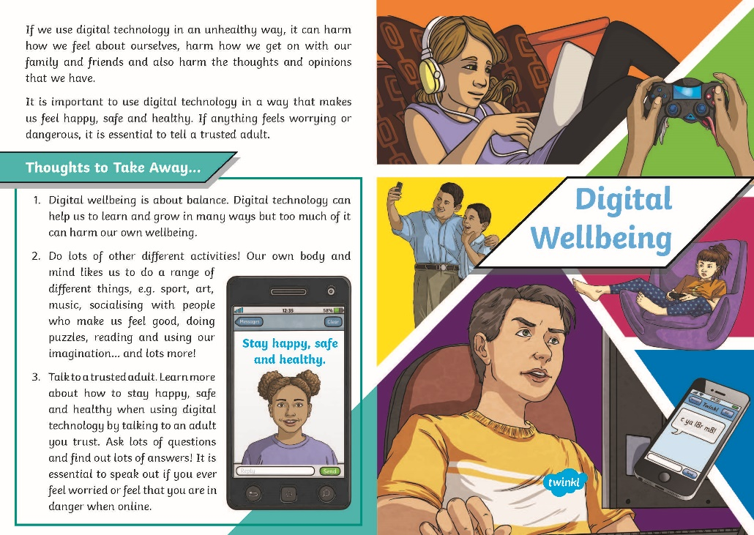
Digital Wellbeing
With your parent, read the Digital Wellbeing Information Sheet.
After you have finished, talk together about your answers to these questions:
What is digital wellbeing?
What might harm our digital wellbeing?
How can we develop positive
digital wellbeing?
What are your top tips for looking after our mental health and wellbeing
when using the Internet and digital technology?
Consolidating
Reflecting

Slide 12
Consolidating

Slide 13

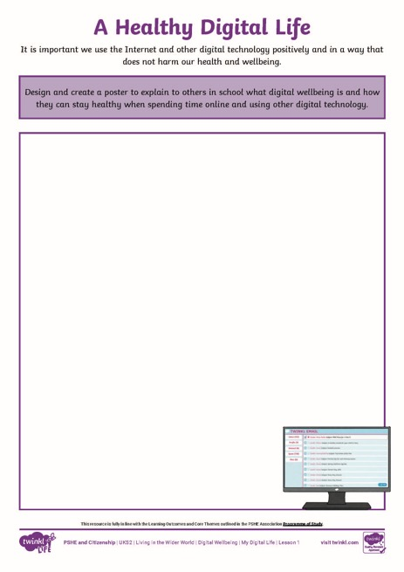
A Healthy Digital Life
It is important we use the Internet and other digital technology positively and in a way that does not harm our health and wellbeing.
Design and create a poster to explain to others what digital wellbeing is and how they can stay healthy when spending time online and using other digital technology. Use the word bank below to help you.
Word Bank
online, negative, privacy, Internet,
activities, honest, balance, trusted adult,
Internet safety, time management,
kindness, happy, digital wellbeing, respect,
mental health, age-appropriate, positive,
screen time

Slide 14
Reflecting

Slide 15
Looking After My
Digital Wellbeing
What steps are you going to take to develop positive digital wellbeing and
have a healthy digital life?
Remember, if anything about being online is worrying or frightening you, it is important to talk to an adult you trust - tell them what is happening and ask for help.
Let’s do all we can to have a healthy digital life, look after our digital
wellbeing and the digital wellbeing of others too!

Slide 16
The Big Questions

Slide 17


How can we look after our mental health and emotional wellbeing when
spending time online?
How can the Internet be used positively?
How can
it be used negatively?
What have you learnt today?
How will it help you in your daily life?

Slide 18
Aim
I can identify the benefits of the Internet and know how to look after my digital wellbeing.
Success Criteria
I can recognise that the Internet plays an increasingly big role in our daily lives.
I can identify the positive and negative uses of the Internet.
I can explain what digital wellbeing means and understand how to
look after my mental health and emotional wellbeing when I am online, including effectively managing my time.
I can think about steps I am going to take to have a healthy
digital life.
This resource is fully in line with the Learning Outcomes and Core Themes outlined in the PSHE Association’s Programme of Study.

