Slide 1
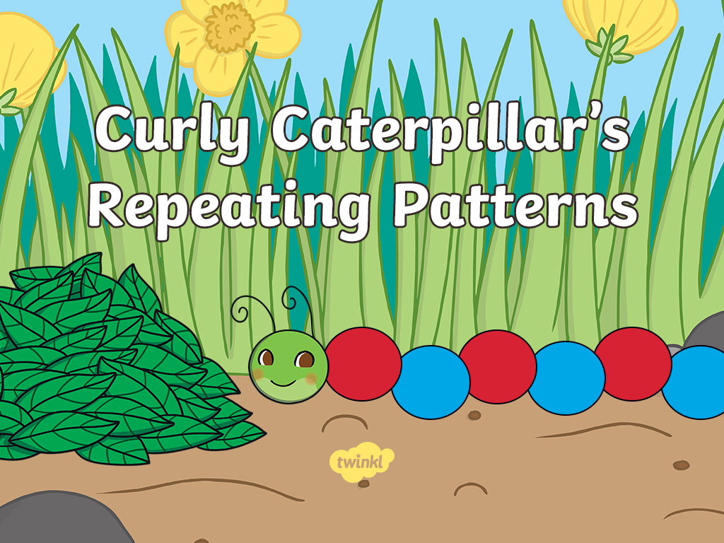

Slide 2
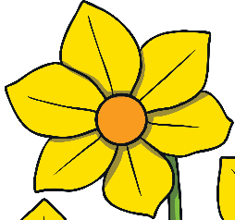
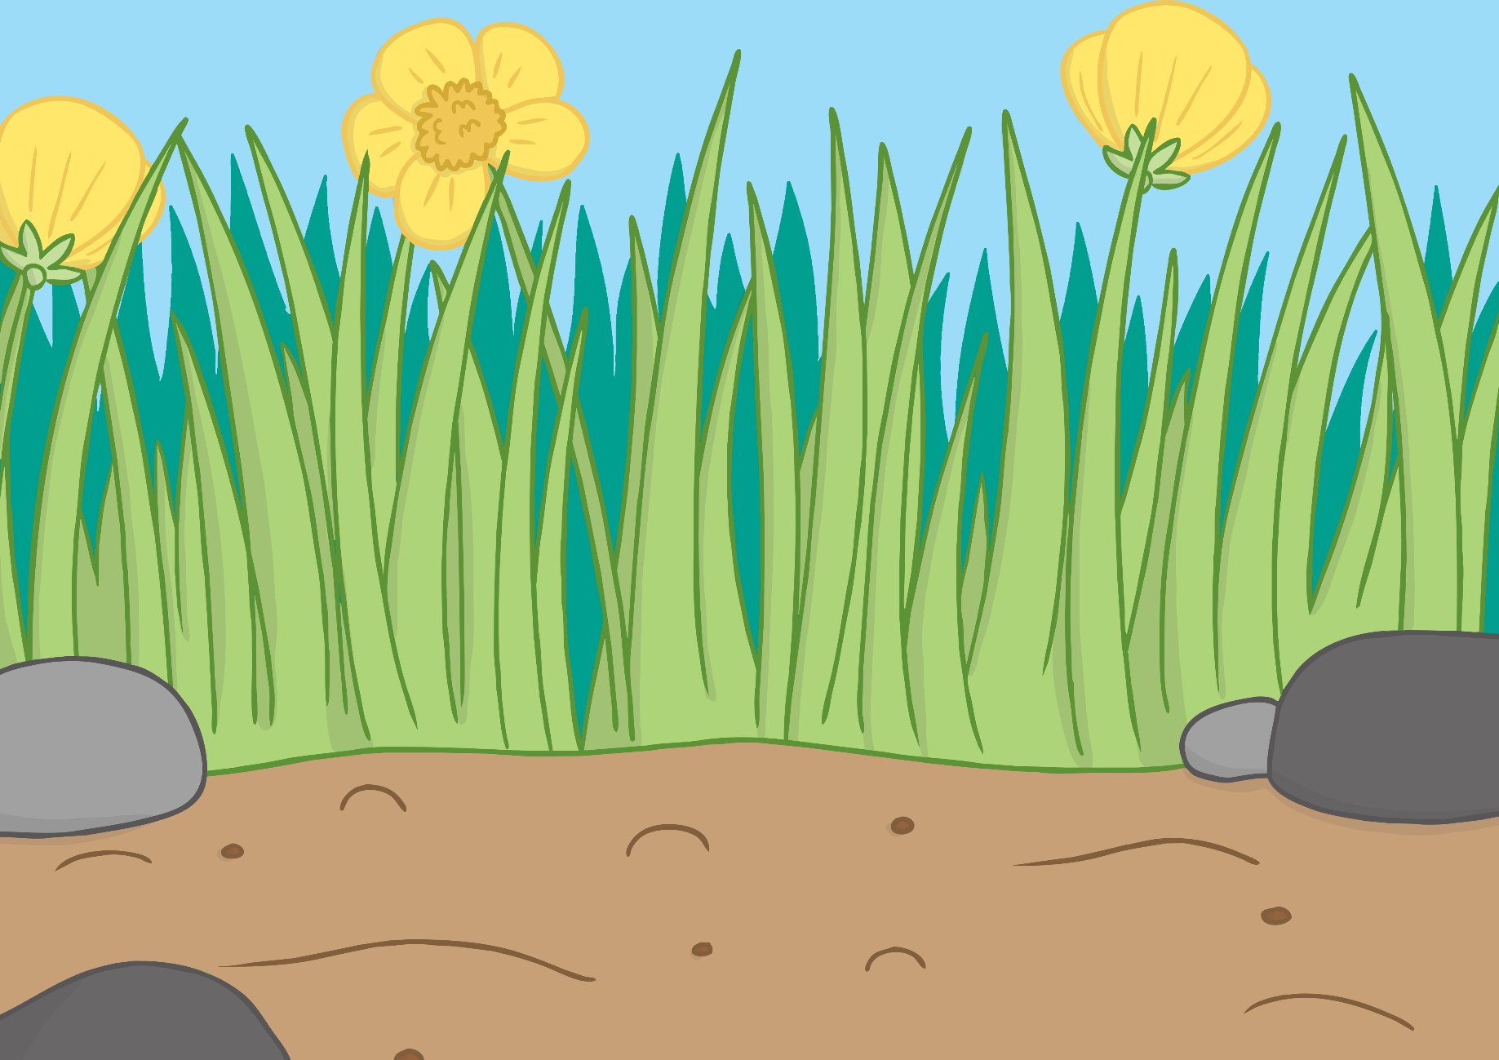
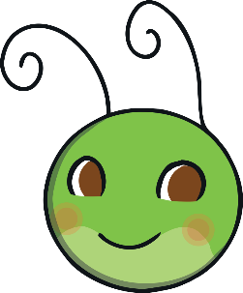



Curly Caterpillar likes to show repeating patterns.
Click on the flower and watch the colours on Curly’s body light up. Can you say the colour names as they light?
What do you notice about the pattern?
Which colour do you think would come next?

Slide 3



Can you help Curly Caterpillar finish the pattern?
Say the colour names on Curly’s body.
Try again!
The last part of Curly’s body needs a colour. Which colour should this be?
Well done!

Slide 4



Can you help Curly Caterpillar finish the pattern?
Say the colour names on Curly’s body.
Try again!
The last part of Curly’s body needs a colour. Which colour should this be?
Great job!

Slide 5

A colour is missing from Curly’s pattern!
Say the colour names on Curly’s body. Which colour is missing?
Try again!
The last part of Curly’s body needs a colour. Which colour should this be?
Super!

Slide 6



Can you help Curly Caterpillar finish the pattern? This time there are three colours.
Say the colour names on Curly’s body.
Try again!
The last part of Curly’s body needs a colour. Which colour should this be?
Brilliant!

Slide 7






Can you help Curly Caterpillar finish the pattern?
Say the colour names on Curly’s body.
Try again!
The last part of Curly’s body needs a colour. Which colour should this be?
You are great at this!

Slide 8








One of Curly’s colours is missing!
Can you say the colour pattern? One colour is missing.
The last part of Curly’s body needs a colour. Which colour should this be?
Fantastic!
Try again!
How many times is the pattern repeated?

Slide 9
