Slide 1



LIFE/work balance
We have started a #LIFEworkbalance campaign and we need your help to complete our LIFE/work balance survey.
We hope to publish the results soon, so please give 15 minutes of your time to help us get a true picture of school life.
Want to be a part of this campaign? Take the survey on our website and share it with your colleagues!
© Classroom Secrets Limited 2018

Slide 2
Year 2 – Autumn Block 1 – Place Value – Ordering Numbers and Objects
About This Resource:
This PowerPoint has been designed to support your teaching of this small step. It includes a starter activity and an example of each question from the Varied Fluency and Reasoning and Problem Solving resources also provided in this pack. You can choose to work through all examples provided or a selection of them depending on the needs of your class.
National Curriculum Objectives:
Mathematics Year 2: (2N2a) Read and write numbers to at least 100 in numerals and in words
Mathematics Year 2: (2N4) Identify, represent and estimate numbers using different representations, including the number line
Mathematics Year 2: (2N2b) Compare and order numbers from 0 up to 100; use <, > and = signs
More Year 2 Place Value resources.
Did you like this resource? Don’t forget to review it on our website.
© Classroom Secrets Limited 2018

Slide 3
Year 2 – Autumn Block 1 – Place Value
Step 8: Ordering Numbers and Objects
© Classroom Secrets Limited 2018

Slide 4
Introduction
Match the cards to the correct number sentence.
3 tens and 6 ones < _______
82 > _______
20 + 45 = _______
65
2 tens
40 + 3
© Classroom Secrets Limited 2018

Slide 5
Introduction
Match the cards to the correct number sentence.
3 tens and 6 ones < _______
82 > _______
20 + 45 = _______
65
2 tens
40 + 3
40 + 3
2 tens
65
© Classroom Secrets Limited 2018

Slide 6
Varied Fluency 1
Order the representations from greatest to smallest.
A. | B.
eighty-four
● | ● | ● | ●
● | ● | ● | ●
● | ● | ● | ●
● | ● | ● | ●
● | ● | ● | ●
● | ● | ● | ●
● | ● | ● | ●
C.
thirty
© Classroom Secrets Limited 2018

Slide 7
Varied Fluency 1
Order the representations from greatest to smallest.
A, C, B
84, 30, 28
A. | B.
eighty-four
● | ● | ● | ●
● | ● | ● | ●
● | ● | ● | ●
● | ● | ● | ●
● | ● | ● | ●
● | ● | ● | ●
● | ● | ● | ●
C.
thirty
© Classroom Secrets Limited 2018

Slide 8
Varied Fluency 2
Order the numbers from smallest to greatest.
31 | 61 | nine | thirty-six | 43 | 11 | fifty
© Classroom Secrets Limited 2018

Slide 9
Varied Fluency 2
Order the numbers from smallest to greatest.
31 | 61 | nine | thirty-six | 43 | 11 | fifty
nine | 11 | 31 | thirty-six | 43 | fifty | 61
© Classroom Secrets Limited 2018

Slide 10
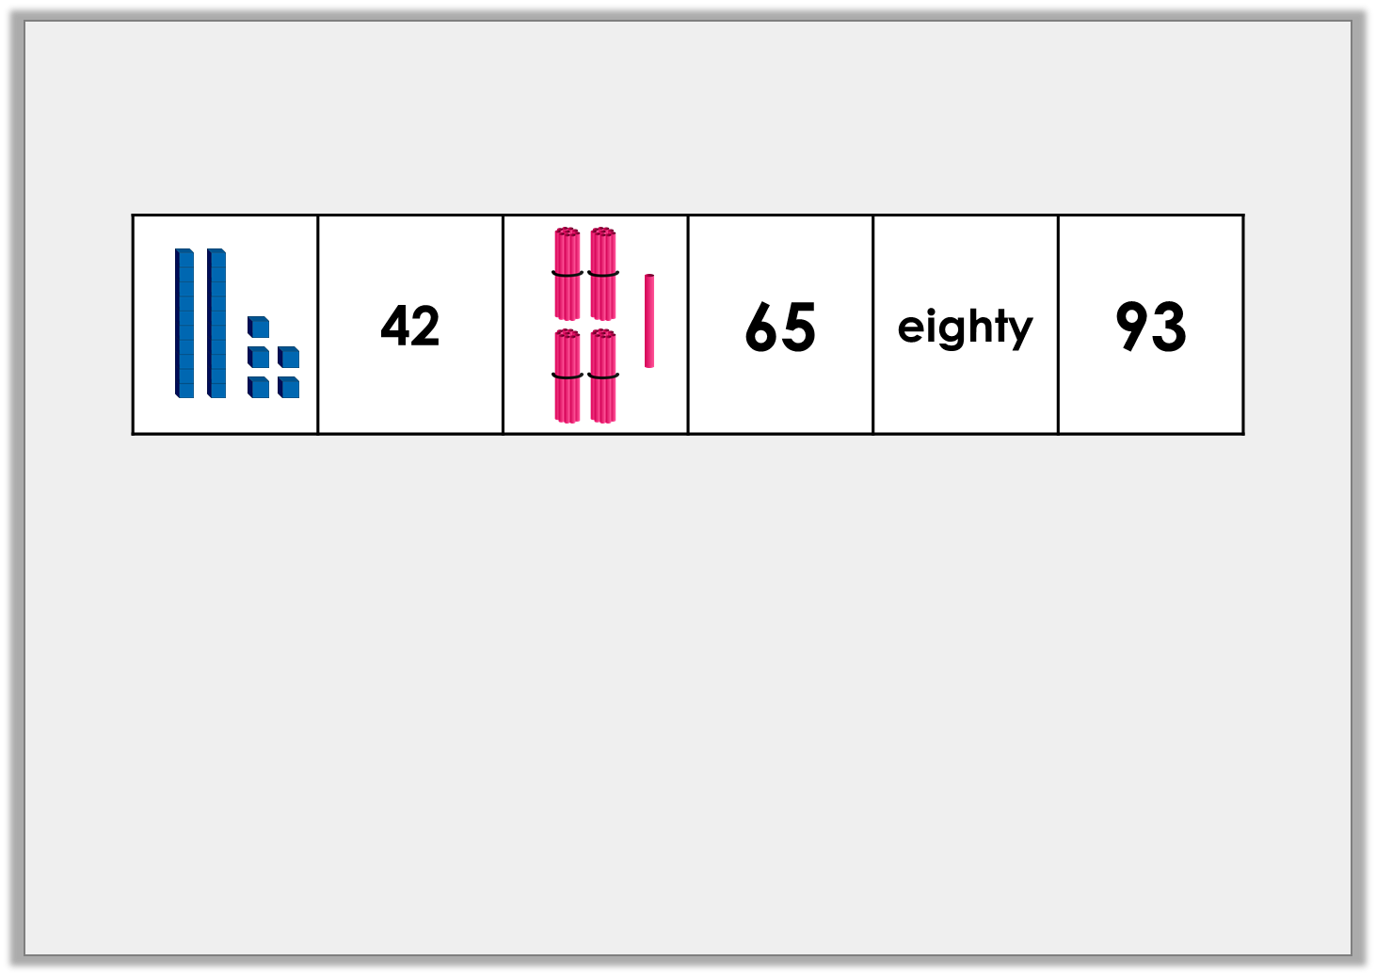
Varied Fluency 3
True or false? These numbers are ordered from smallest to greatest.
© Classroom Secrets Limited 2018

Slide 11
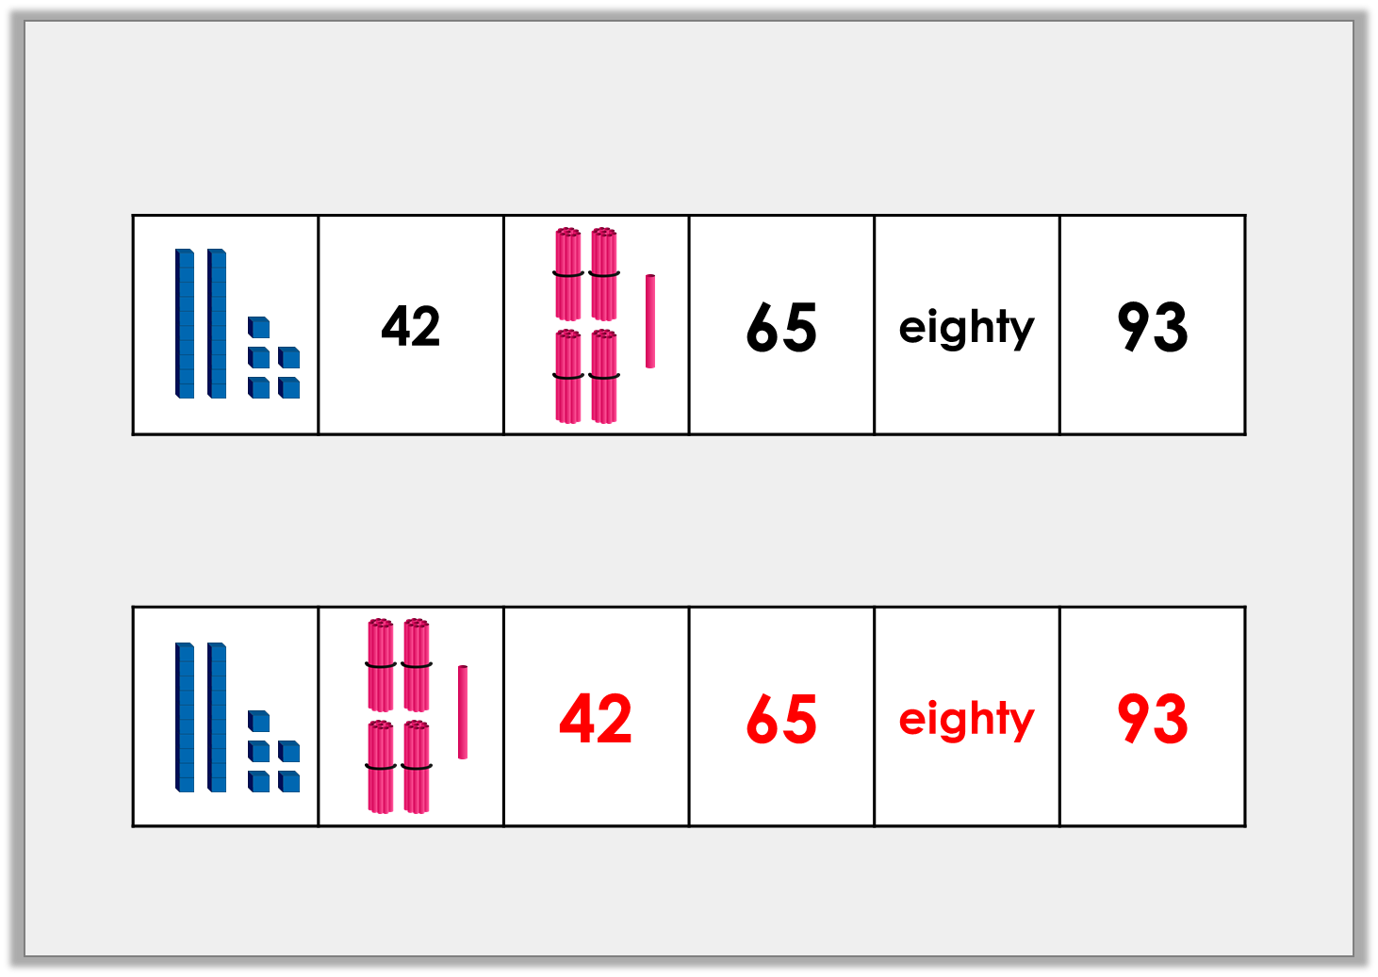
Varied Fluency 3
True or false? These numbers are ordered from smallest to greatest.
False. 42 is greater than 41.
© Classroom Secrets Limited 2018

Slide 12
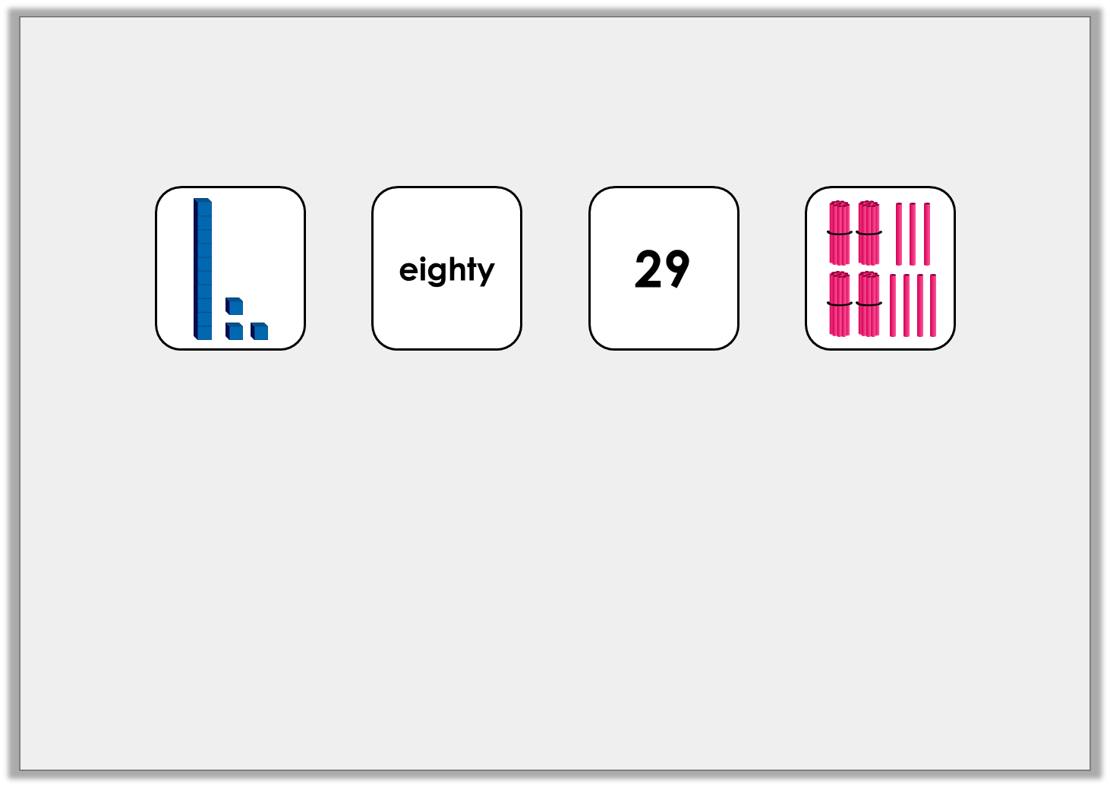
Varied Fluency 4
Put the cards in order to make the statement true.
 | > |  | > |  | >
© Classroom Secrets Limited 2018

Slide 13
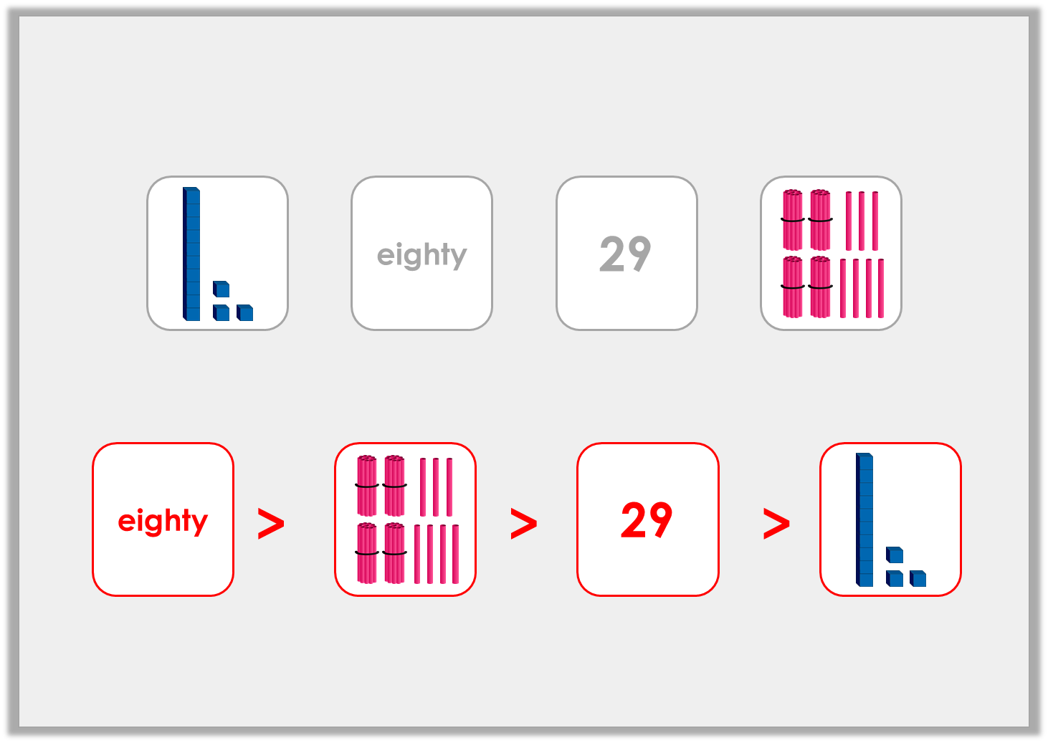
Varied Fluency 4
Put the cards in order to make the statement true.
© Classroom Secrets Limited 2018

Slide 14
Problem Solving 1
Travel through the maze moving to a smaller number each time.
55 | 60 | 98 | 11
42 | 30 | 21 | 29
72 | 35 | 15 | 29
35 | 10 | 6 | 46
Start
Finish
© Classroom Secrets Limited 2018

Slide 15
Problem Solving 1
Travel through the maze moving to a smaller number each time.
55 | 60 | 98 | 11
42 | 30 | 21 | 29
72 | 35 | 15 | 29
35 | 10 | 6 | 46
Start
Finish
© Classroom Secrets Limited 2018

Slide 16
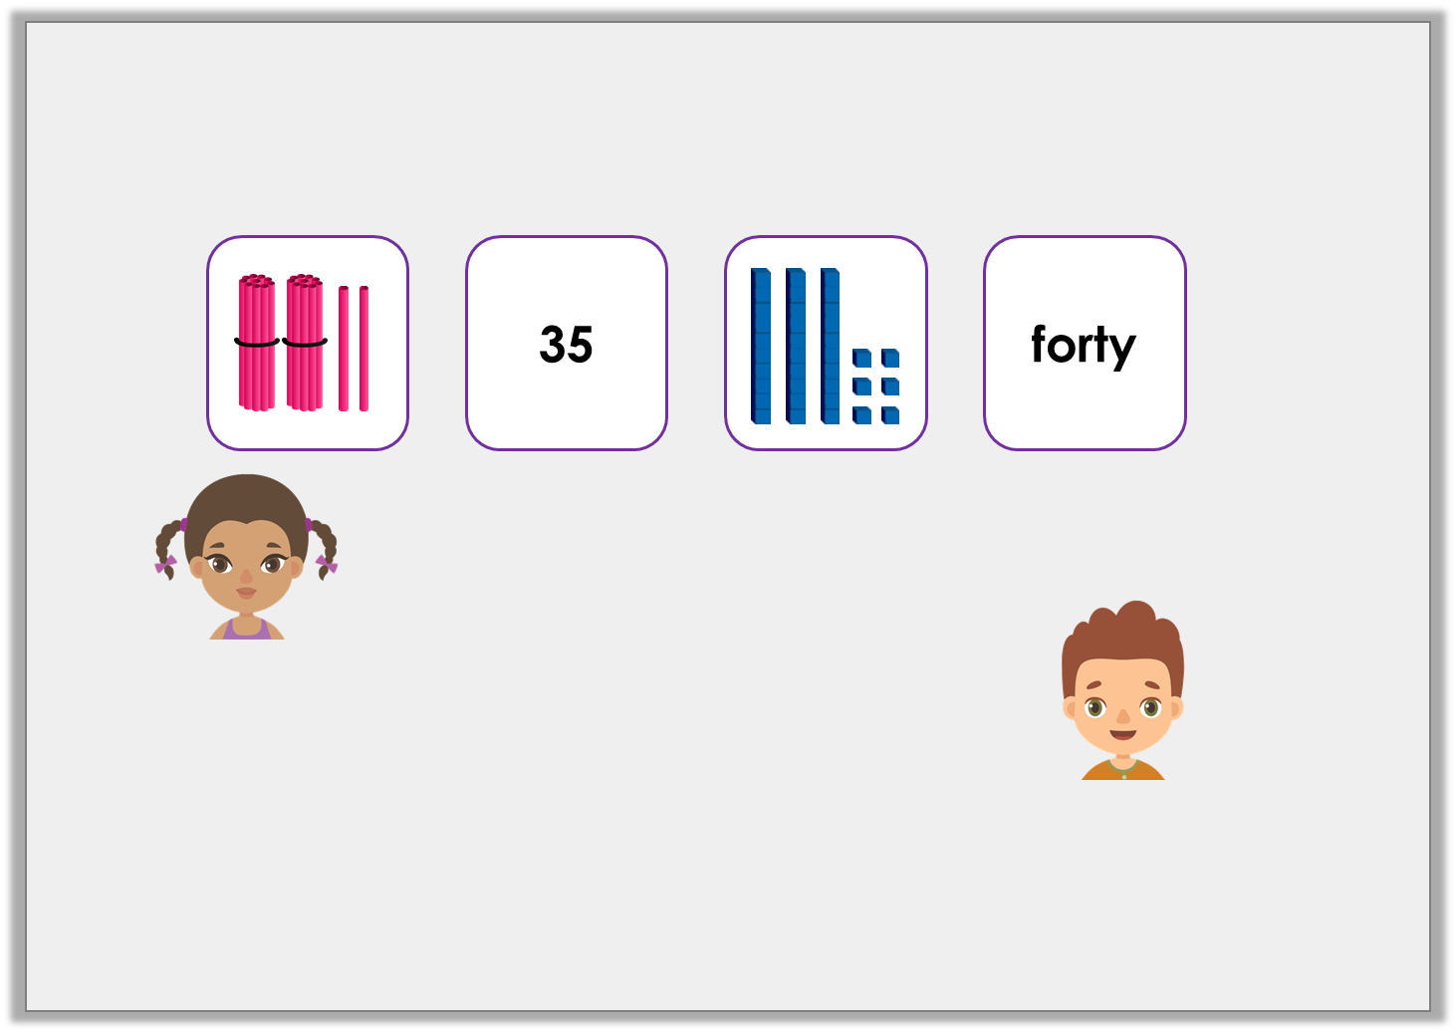
Reasoning 1
Pat and Suzie have ordered some numbers from smallest to greatest.
Who is correct? Explain how you know.
The next number could be 42.
Suzie
The next number could be 60.
Pat
© Classroom Secrets Limited 2018

Slide 17
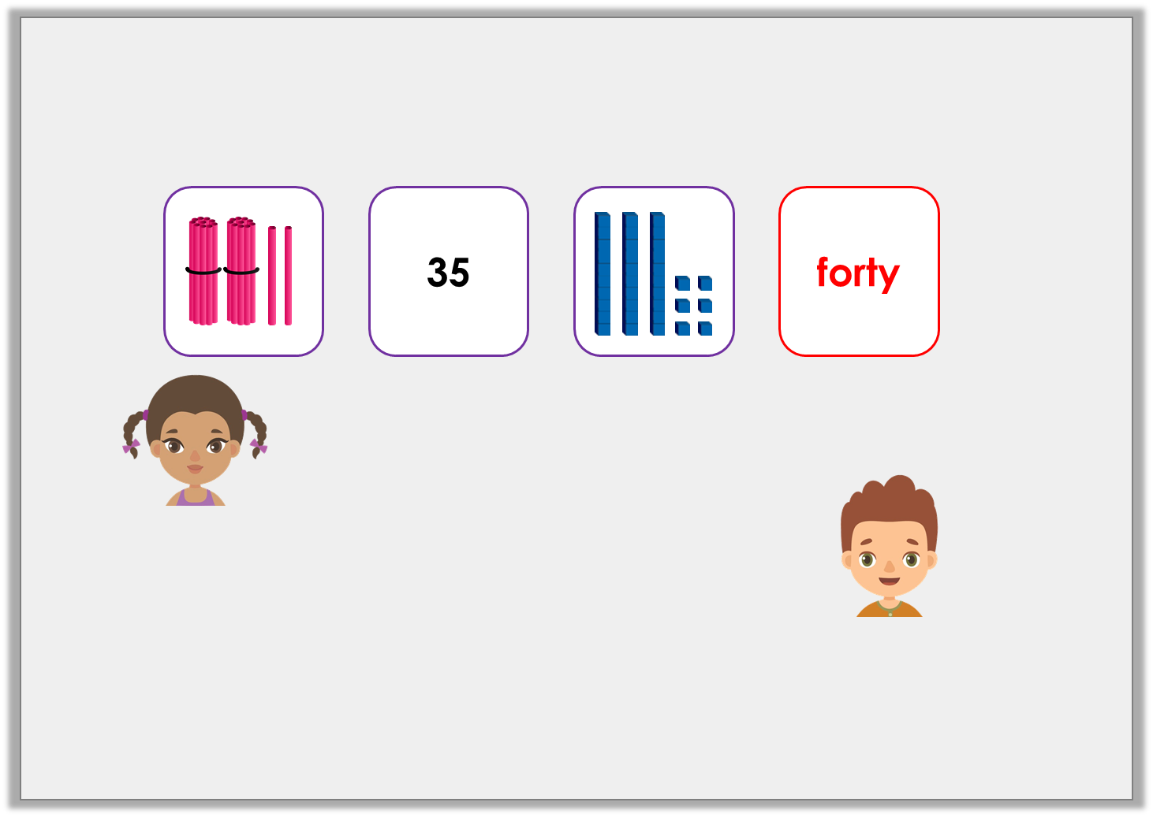
Reasoning 1
Pat and Suzie have ordered some numbers from smallest to greatest.
Who is correct? Explain how you know.
They are both correct because…
The next number could be 42.
Suzie
The next number could be 60.
Pat
© Classroom Secrets Limited 2018

Slide 18
Reasoning 1
Pat and Suzie have ordered some numbers from smallest to greatest.
Who is correct? Explain how you know.
They are both correct because 42 and 60 are greater than 40.
The next number could be 42.
Suzie
The next number could be 60.
Pat
© Classroom Secrets Limited 2018

Slide 19
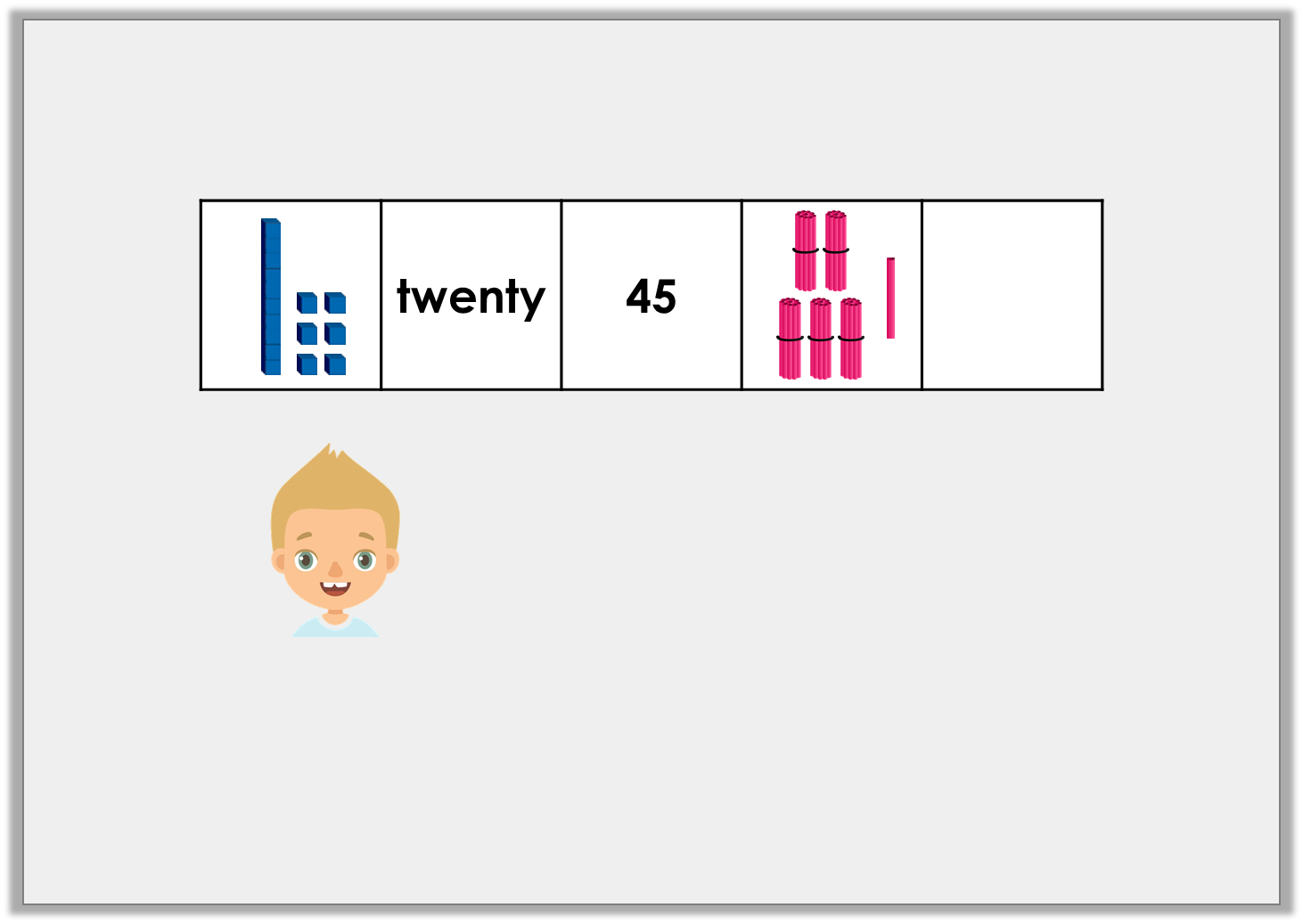
Reasoning 2
Mike is ordering numbers from smallest to greatest.
Is he correct? Explain how you know.
53 could be the missing number.
© Classroom Secrets Limited 2018

Slide 20
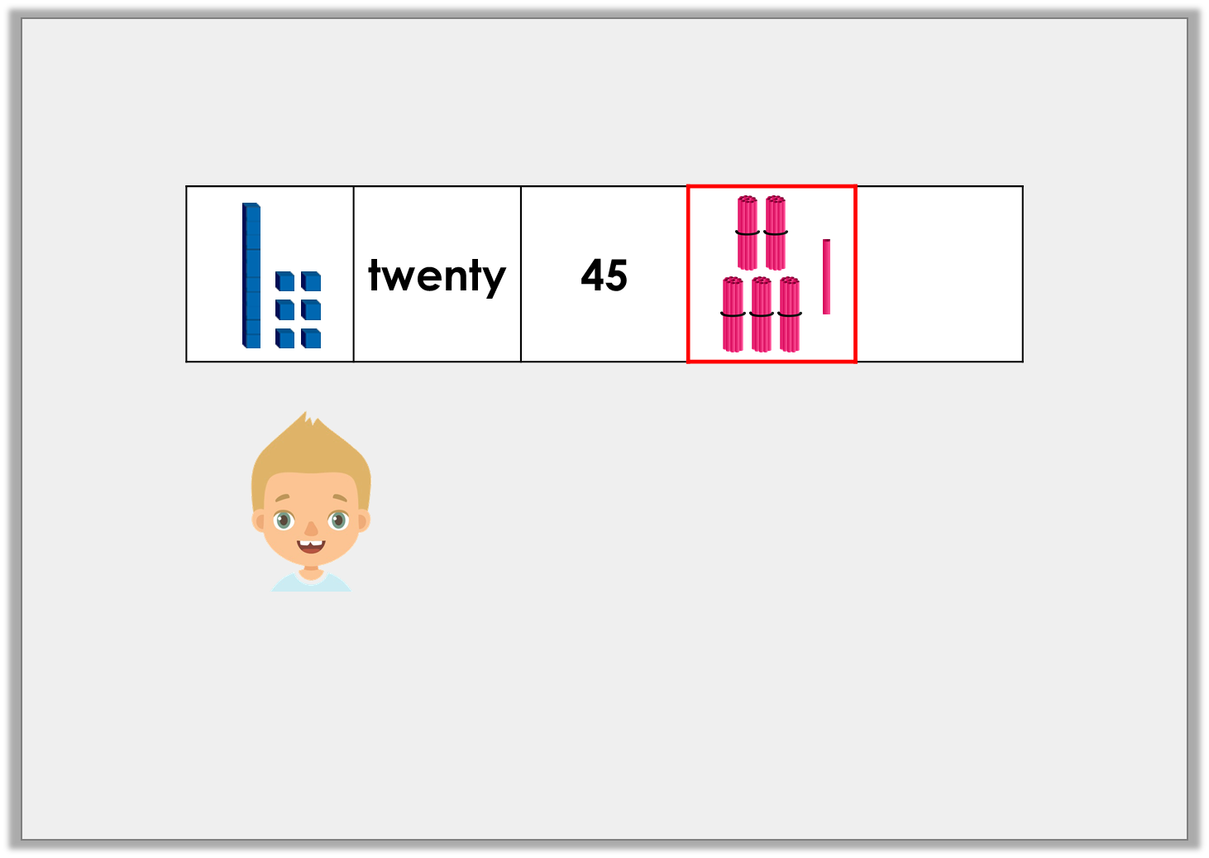
Reasoning 2
Mike is ordering numbers from smallest to greatest.
Is he correct? Explain how you know.
He is correct because…
53 could be the missing number.
© Classroom Secrets Limited 2018

Slide 21
Reasoning 2
Mike is ordering numbers from smallest to greatest.
Is he correct? Explain how you know.
He is correct because 53 is greater than 51.
53 could be the missing number.
© Classroom Secrets Limited 2018

