Slide 1


Catch it, Check it, Replace it!

Slide 2


Think of three adjectives to describe how you have been feeling lately?

Slide 3
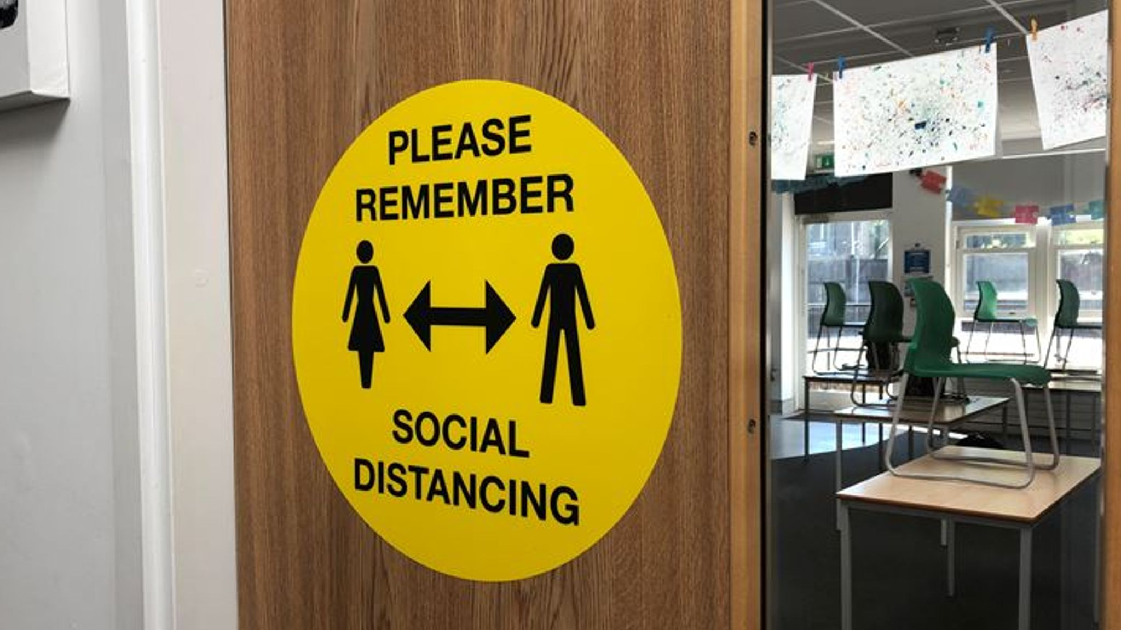

What changes have you come across at school and elsewhere?

Slide 4
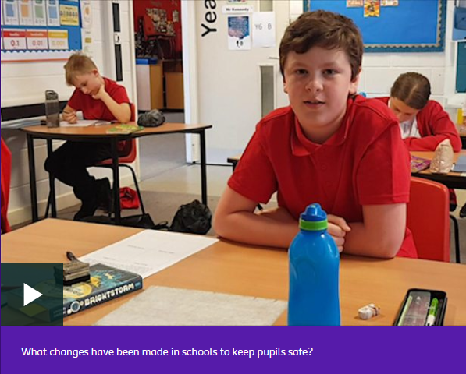

Notes:
https://www.bbc.co.uk/newsround/52821345 – Newsround clip

Slide 5



Slide 6

Q. How do we determine if a thought is helpful or unhelpful?
Q. How does that thought make you feel?

Slide 7

Notes:
https://www.youtube.com/watch?v=PnxWRwQYdIQ – Think Ninja clip

Slide 8
Catch it, Check it, Replace it...
Unhelpful thought | Challenge the thought | Replace with a more helpful thought
e.g. What if I can’t catch up with my schoolwork | Remember that lots of pupils are in the same boat I guess I could try my best to do what work I can now | I will always have support from my school and friends to help catch up on anything important that I’ve missed

Slide 9

How did you get on?
Remember, it will take practice to change unhelpful thinking patterns and that’s okay…

Slide 10

Notes:
https://youtu.be/tfkhkFwCtxs - Reframe Unhelpful Thoughts from Every Mind Matters

Slide 11






Your GP
Shout!
Kooth
The Mix
Samaritans
Young Minds

