Slide 1

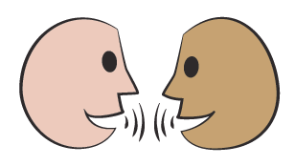

Solve problems involving unequal quantities.
This stick has twice as many red cubes as blue cubes. Draw other sticks which also have twice as many red cubes as blue cubes, but with a different total number of cubes.
What fraction of the stick is red?
4 parts out of 6, ⁴/_{6,} simplifying to ²/₃.
All your sticks have twice as many red cubes as blue cubes. Although they have different numbers of cubes, they all have the same ratio of red to blue cubes.
The ratio is 2 red cubes for every 1 blue cube.
We can write this ratio as 2:1.
What fraction of the stick is blue?
2 parts out of 6, ²/₆, simplifying to ¹/₃.
These fractions are the same for all your sticks too!

Slide 2
Solve problems involving unequal quantities.
e.g.
Draw a stick with the ratio of 3 red cubes for every 1 blue cube.
What fraction of the stick is red?
What fraction of the stick is blue?
6 parts out of 8, ⁶/_{8,} simplifying to ³/₄.
2 parts out of 8, ²/₈, simplifying to ¹/₄.
e.g.
Now draw a stick with the ratio of 3 red cubes for every 2 blue cubes.
What fraction of the stick is red?
What fraction of the stick is blue?
3 parts out of 5, ³/_{5.}
2 parts out of 5, ²/_{5.}

