Slide 1

- Writing -
How to support your child

Slide 2
Why have you been invited into school today?
Our most recent Parent Survey showed that parents would appreciate support in understanding the maths and the writing curriculum at Whitchurch Combined School and how best to help their children in these areas.
We offered a maths workshop in October and today we would like to offer a similar guide to writing.

Slide 3

Our aims today are :
to explain why writing is important and has such a vital place in everyday life .
to gain some understanding of how we teach writing at Whitchurch Combined School with a particular focus on grammar.
to look at ways of helping your child at home.

Slide 4
Importance of Writing
Writing and reading are part of every aspect of your child’s life and indeed, into adulthood and therefore very important.
Writing makes children's thinking and learning visible and permanent.
It allows children to express their views and feelings..
It provides children with opportunities to explain and refine their ideas to others and themselves.
Evidence suggests that children who can compose well structured and meaningful writing are more likely to achieve success in further education and in the world of work. (EEF)

Slide 5
How We Teach Writing at Whitchurch
Hopefully, we have now explained why it is so important we support our children in becoming successful writers.
What do we do in school?
From EYFS to Year 6, our Writing Curriculum has a huge focus on writing, reading as a writer, handwriting, grammar and phonics /spelling.

Slide 6
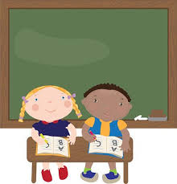
From EYFS onwards, children will spend time every week on writing tasks, handwriting, grammar work and phonics/spelling.
Time allocation for each area will be adjusted according to age and need.

Slide 7

Handwriting
In Reception and KS1, we teach children using the Lesley Clarke phonics and handwriting scheme.
This begins in reception, with accurate letter formation and progresses from year 2 or 3 (as appropriate) to joining letters using an un-looped cursive script•
Handwriting is practised 3 times a week
In KS2, handwriting is initially taught as a focused session through writing lessons.

Slide 8
Handwriting
In KS2, handwriting is initially taught as a focused session at least twice a week depending on need.
By Year 5 and 6, handwriting is mainly taught through writing lessons, but again, this is adjusted according to need with focused handwriting sessions
taught as appropriate.

Slide 9

This shows the letter formations for the alphabet.
It includes dots, which is where we begin the letters and directions to move the pencil or pen.
Please practise these with your child as bad habits are difficult to correct later on.

Slide 10
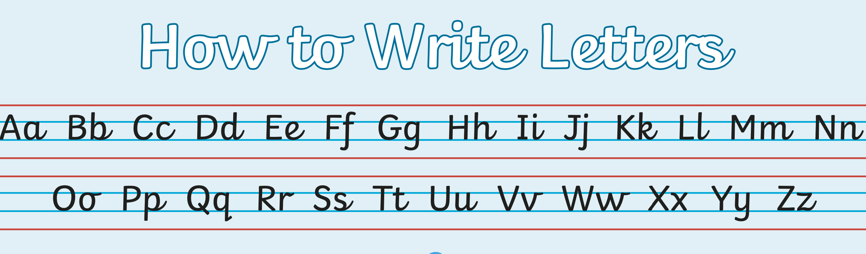
This shows the letter formations for the alphabet as we progress and prepare to join our writing.
The flicks are important as this is where the letters will join.

Slide 11
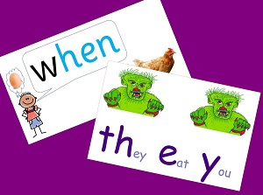

Phonics / Spelling
In Reception and KS1, we teach children using
the Lesley Clarke phonics scheme.
As children are ready to progress, we move on to the Spelling Shed scheme which continues to use a phonics-based approach to learning the key spelling patterns whilst also addressing the many irregular words in our language.

Slide 12
Writing
We teach writing as a process (adjusted by age):
Reading and exploring examples of the text type being taught – making notes for the working wall. (This is where we ‘read as writers’)
Highlighting the features of the text type – text structure & layout, language choices, sentence types and other grammatical features.
Planning our own version of the writing – sometimes in small peer groups; sometimes in groups guided by an adult; sometimes individually.
Trying out our plans through drama or paired discussion
Teacher modelled / guided writing before pupils draft their writing
Proof reading with a partner
Editing and developing – and finally,
Publishing

Slide 13

Writing is not limited to English lessons - Children also access a range of writing opportunities in the different areas of the curriculum as appropriate.
The writing process is taught and practised in English lessons with children having the opportunity to apply the skills through other curricular areas.

Slide 14

Grammar
It is important children understand grammar as it is, to English, what the times tables are to maths.
Grammar is what makes language work.
Using the correct grammar and punctuation is vital for accurate communication – eg: a piece of writing without any full stops, does not make sense.
As children progress through their primary education (and further) they will learn how to use grammar and punctuation to control their writing – so it is good to have an early grasp of the basics upon which they can build.

Slide 15
Grammar
Our weekly grammar lessons are linked to our writing units wherever possible, so children can see the impact of using grammar effectively.
This also enables us to teach the key skills that the children are then expected to use within their writing.
We also have ‘flashback’ sessions at the beginning of English lessons twice a week, to keep the terminology fresh in the children’s minds.

Slide 16
Grammar
Grammar is arguably one of the more complex areas of the English curriculum and this could be due, in part, to the many complex terms the children are expected to learn.
Without doubt, most of our children will use the correct grammatical structures hundreds of times a day in their regular conversations, but knowing the correct grammatical term for these structures, can be confusing – even for adults!

Slide 17
Grammar
So how can we support our children in learning these terms and the correct application?
At Whitchurch Combined School, we apply Rosenshine’s Principles for Education which, very briefly, involves:
new learning being presented in small steps
teachers providing models of the new learning
lots of questioning to check pupils’ understanding
regular review of previous learning

Slide 18
Grammar
By regularly reviewing previous learning, through the ‘flashback’ activities and by reference to them during modelled and guided writing, as well as through whole class reading, we hope to keep them relevant in the children’s minds as well as check their understanding (to see if revision is needed)
And this is a way you can also support your children at home. When you are reading with your child, talk about the grammar you see in the text (as well as discussing what has been read!)
But … what if you’re unsure of grammar term - what a ‘modal verb’ or an ‘expanded noun phrase’ looks like – what could you do?

Slide 19

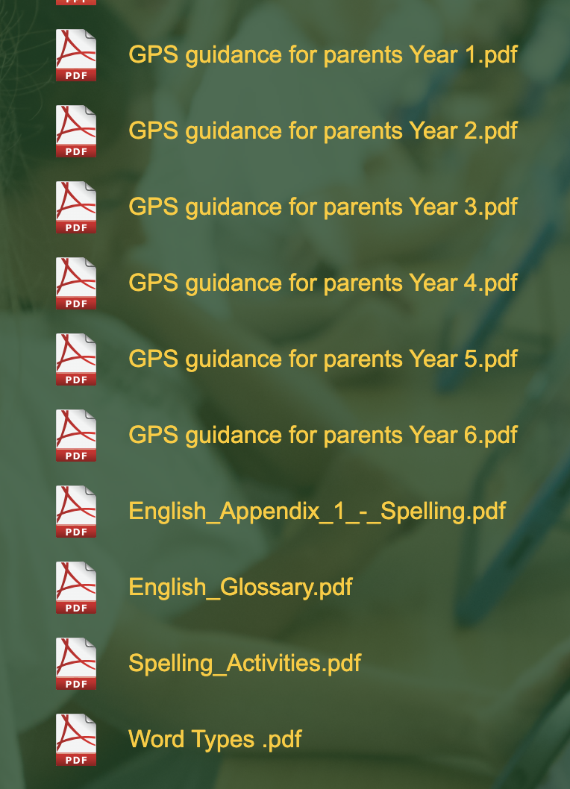
Grammar
Information on the School Website:
Curriculum Page – English – Writing – then click on
This will lead you to a wealth
of information regarding GPS.
The English Glossary is a guide
published by the DfE, with clear
definitiions of every term included
in the Primary curriculum.

Slide 20
Grammar
You may be surprised that you know more than you think!
One of the basic units of English is the sentence.
The curriculum defines a sentence as “a group of words which are grammatically connected to each other.”
A sentence expresses a complete thought and makes sense.
A sentence normally has a subject and a verb.
There are 4 types of sentence.
Statement-assert facts/opinions
Question-a sentence that usually requires an answer
Command-an order which often leaves out the subject of the sentence and often starts with a verb
Exclamation-statements of surprise or strong emotion

Slide 21
Grammar
What type of sentence?
Did you empty the dishwasher?
You did empty the dishwasher.
Empty the dishwasher.
How fantastic that you emptied the dishwasher!

Slide 22
Grammar
What type of sentence?
Did you empty the dishwasher? question
You did empty the dishwasher. statement
Empty the dishwasher. command
How fantastic that you emptied the dishwasher! excalmation

Slide 23
Grammar
Basic Word Classes
Nouns - name of objects, things, ideas, events, places or people. They can be concrete, abstract, common, proper, or collective.
Adjectives - describe nouns.
Verbs - are doing / action words or a state of being.
Adverbs - describe how, where, and when things happen. They often ‘describe’ verbs.

Slide 24
Grammar
Basic Word Classes
Identify the nouns in this sentence
The bakery stood on the corner of a street in Buckingham.
Identify the verbs in this sentence
Without warning, snow fell heavily from the grey sky and settled on the rooftops, the pavements and the streets which was quite a shock.
Identify the adjectives in this sentence
Along the dark alleyway and into the deserted town centre, the hungry rat scuttled on its soft paws.

Slide 25
Basic Word Classes
Grammar
Identify the nouns in this sentence
The bakery stood on the corner of a street in Buckingham.
Identify the verbs in this sentence
Without warning, snow fell heavily from the grey sky and settled on the rooftops, the pavements and the streets which was quite a shock.
Identify the adjectives in this sentence
Along the dark alleyway and into the deserted town centre, the hungry rat scuttled on its soft paws.

Slide 26
Grammar
Which sentence is correct?
Adam saw his friend in the park and wave.
Adam saw his friend in the park and waved.
Adam sees his friend in the park and wave.
Adam sees his friend in the park and waved.

Slide 27
Grammar
Which sentence is correct?
Adam saw his friend in the park and wave.
Adam saw his friend in the park and waved.
Adam sees his friend in the park and wave.
Adam sees his friend in the park and waved.

Slide 28
Antonyms and Synonyms
Grammar
Two words are antonyms if their meanings are opposite.
eg: hot – cold
light – dark
easy – difficult
Two words are synonyms if their meanings are very similar.
eg: talk – speak
rich – wealthy
sad - unhappy

Slide 29
Grammar
Antonyms and Synonyms
Which two words in the sentence below are synonyms of each other?
He was lucky to win first prize – he knew it was fortunate that his closest rival had decided not to take part.

Slide 30
Grammar
Antonyms and Synonyms
Which two words in the sentence below are synonyms of each other?
He was lucky to win first prize – he knew it was fortunate that his closest rival had decided not to take part.

Slide 31
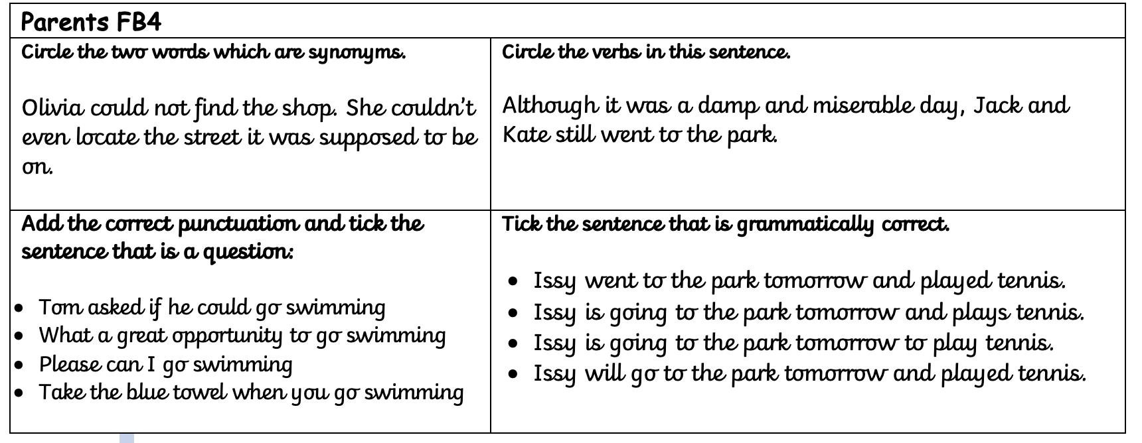
Your turn!
Grammar
You have just learned 4 grammatical terms and practised related questions from the GPS Curriculum.
On your table is a ‘flasbback 4’ activity – have a go at completing it!

Slide 32
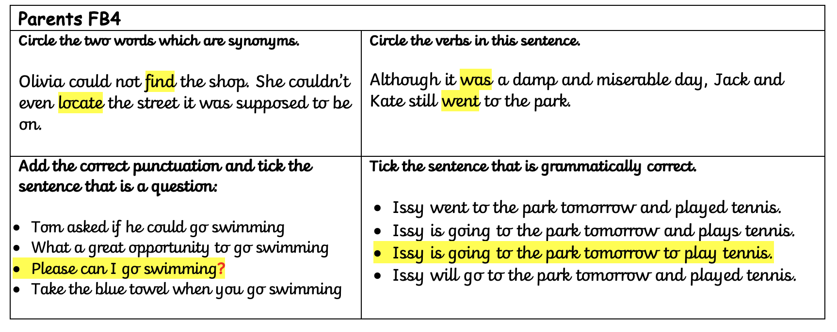
How did you get on?
Grammar

Slide 33
Grammar
How can you help support your child’s writing?
The basis of all good writing is dependent on knowing lots of words and being able to join them together in interesting ways.
Encourage your child to talk.
Explain a game or activity, describe a person, place, picture or thing; retell stories; talk about things they have done e.g. visits, day at school - encourage detail; predict what might happen next in a story, TV programme or sequel to a film; play word games

Slide 34
Grammar
How can you help support your child’s writing?
Be a reading model and read to your child (e.g. stories, poems, factual information such as timetables, magazines, newspaper reports, letters, emails, adverts, instructions)
While you are reading – think about ‘reading as a writer’
– why has the author chosen this word? How does it help you to visualise what is happening?
- Why has the author used a comma (full stop etc) here? How does it help you to understand the story?

Slide 35
How can you help support your child’s writing?
Grammar
Be a writing model and encourage your child to write alongside you for real purposes e.g. shopping lists, birthday/Christmas lists, labels, invitations, thank you letters, emails to friends, postcards, cards for relatives, scrap books of holidays/hobbies/special events, diaries, short stories or poems, menus, bedroom or house rules
Have an exciting selection of writing materials available e.g. a range of pencils, pens, coloured crayons, writing icing, writing soaps for bath time
Praise your child for trying and don’t dwell on mistakes. Focus on content and enjoyment of writing for fun

Slide 36
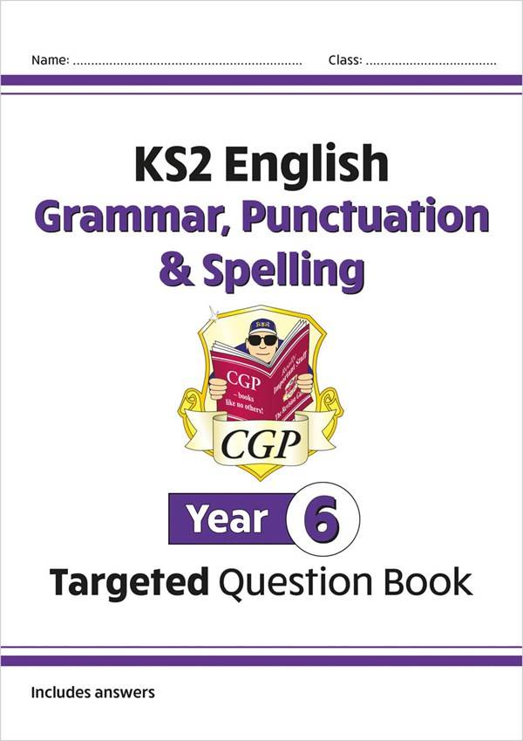
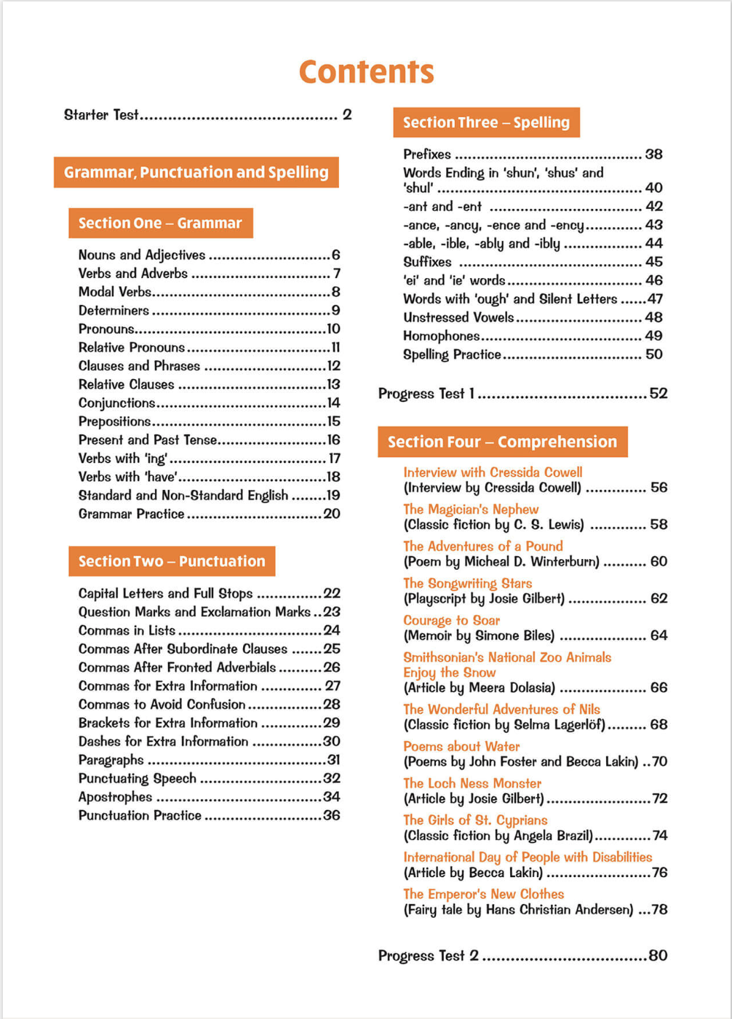
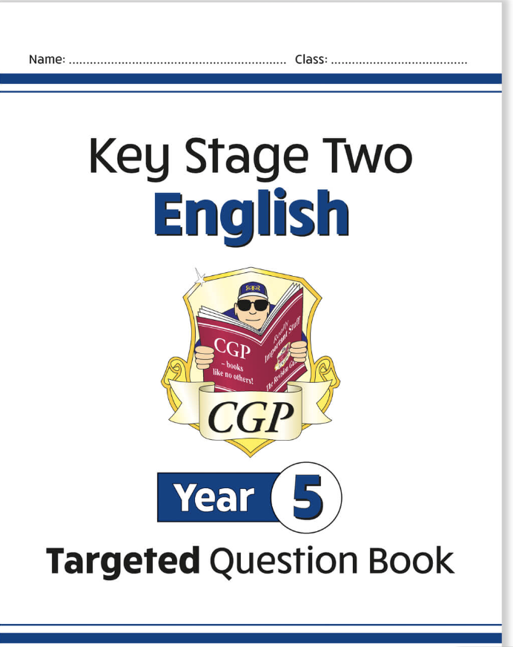
Grammar
Don’t forget to look at the information on the school website.
There are plenty of good books available to help too.

Slide 37
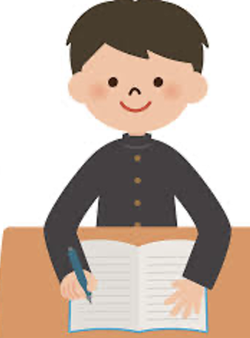
Grammar
We hope this information session has been useful.
This presentation will be available on the school Website and remember, we’re here to help!

