Slide 1
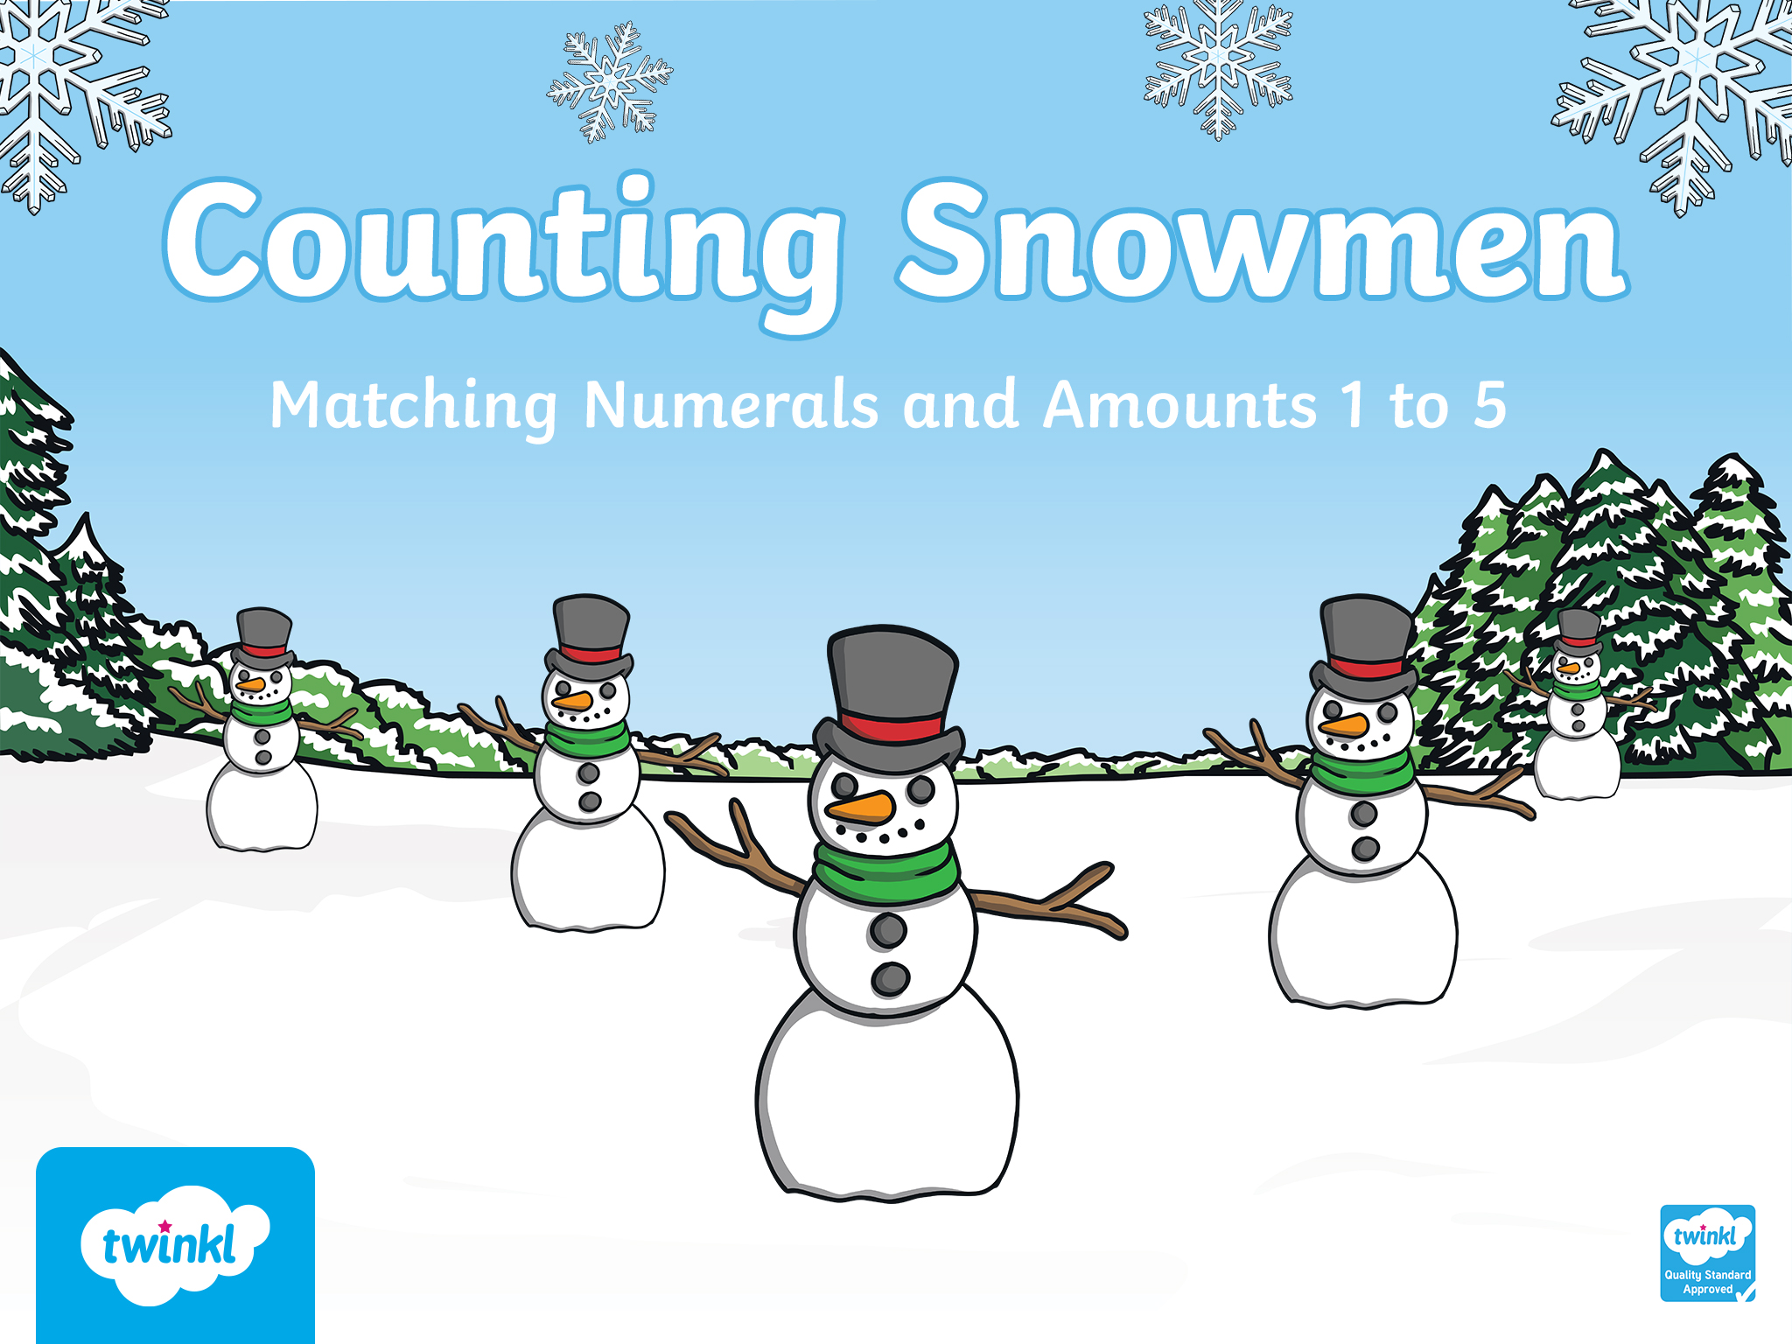

Slide 2
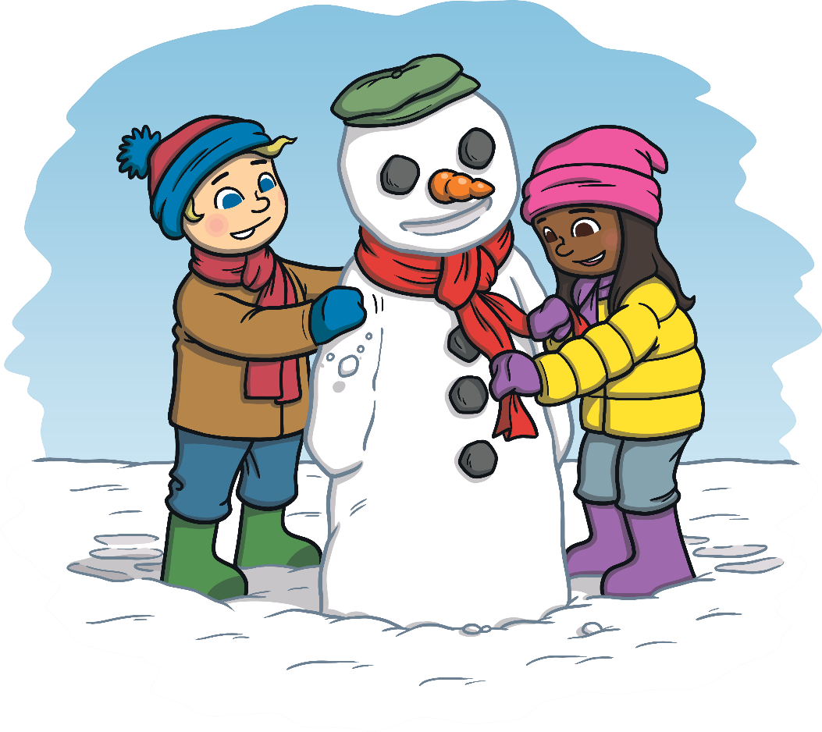
It’s winter time
and it’s snowing!
We have been busy
making snowmen.
Can you help us count how many snowmen we’ve made?

Slide 3



Well done! There is 1 snowman.
How many snowmen can you see?
Try
again.
1
2
3

Slide 4


Can you show me how many snowmen there are using your fingers?
Try
again.
Well done! There are 3 snowmen.
1
4
3

Slide 5


I think I saw 3 snowmen while I was skating. Am I correct?
Try
again.
Well done! There are 5 snowmen.
2
5
3

Slide 6

How many snowmen have I made?
Well done! There are 2 snowmen.
Try
again.
3
1
2

Slide 7

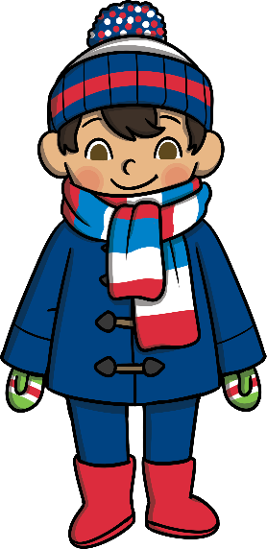
How many snowmen have I made?
Well done! There are 4 snowmen.
Try
again.
4
3
2

Slide 8


