Slide 1
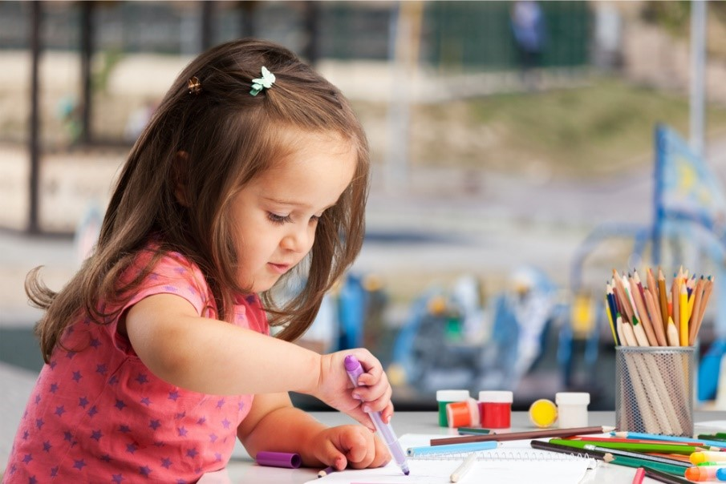
Let’s get writing!
Children need lots of big movements to help them get ready for writing, so here we go…

Slide 2
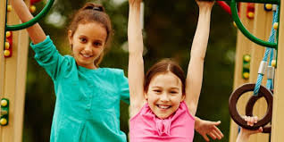
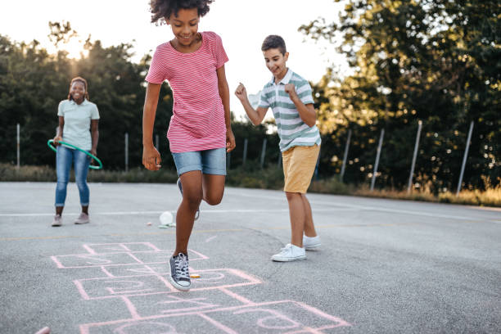
Gross motor activities-
Skipping with a skipping rope
Hanging and swinging
Hopscotch
Throwing paper aeroplanes
Balancing on a line or a beam
Scarf or streamer waving
Sweeping with a broom
Playing with bats and beanbags

Slide 3
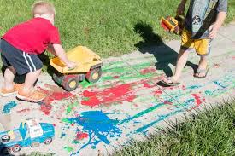
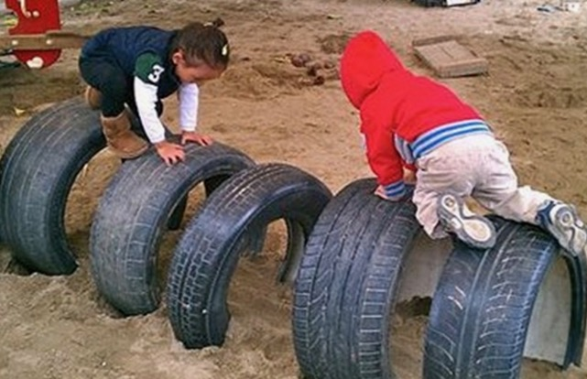
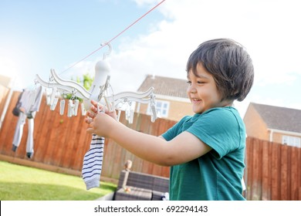
Activities you can do outside-
Play at the park
Make an obstacle course
Help peg the washing out
Help sweep up with a dustpan and brush
Help pick up lego, stones, leaves, coins…
…

Slide 4
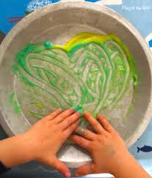
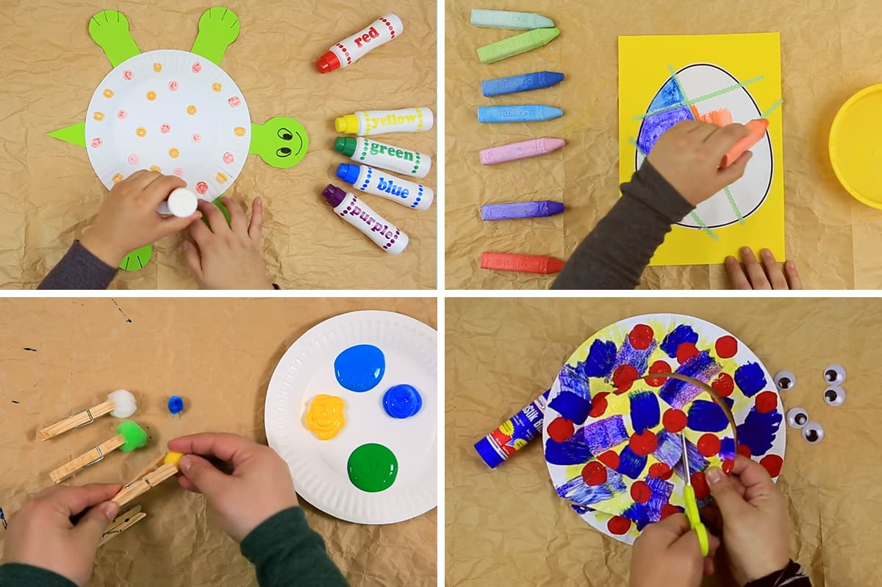
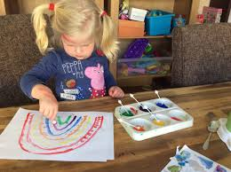
Fine motor activities-
Paint with water/paint/food colouring using large or small brushes
Use big chalks on paper or on the ground outside
Paint with sticks
Decorate the edge of a paper plate with clothes pegs
Cutting and sticking
(and you can probably think of lots more as well!)

