Slide 1
Whitchurch Combined School
Growing today, ready for tomorrow.

Slide 2
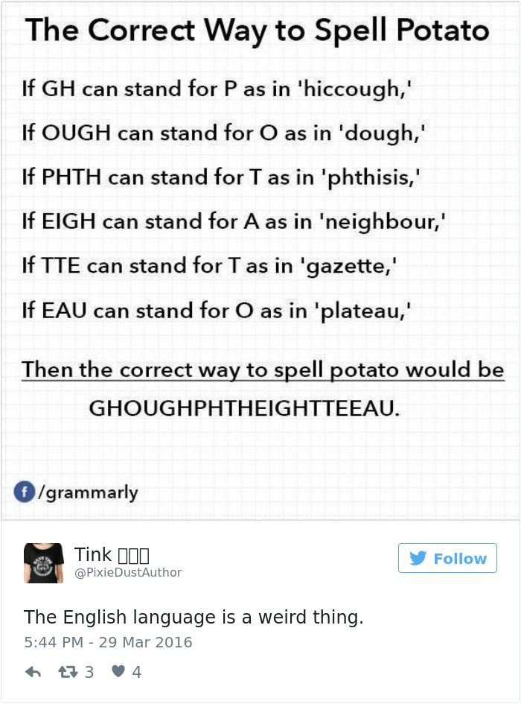


Slide 3
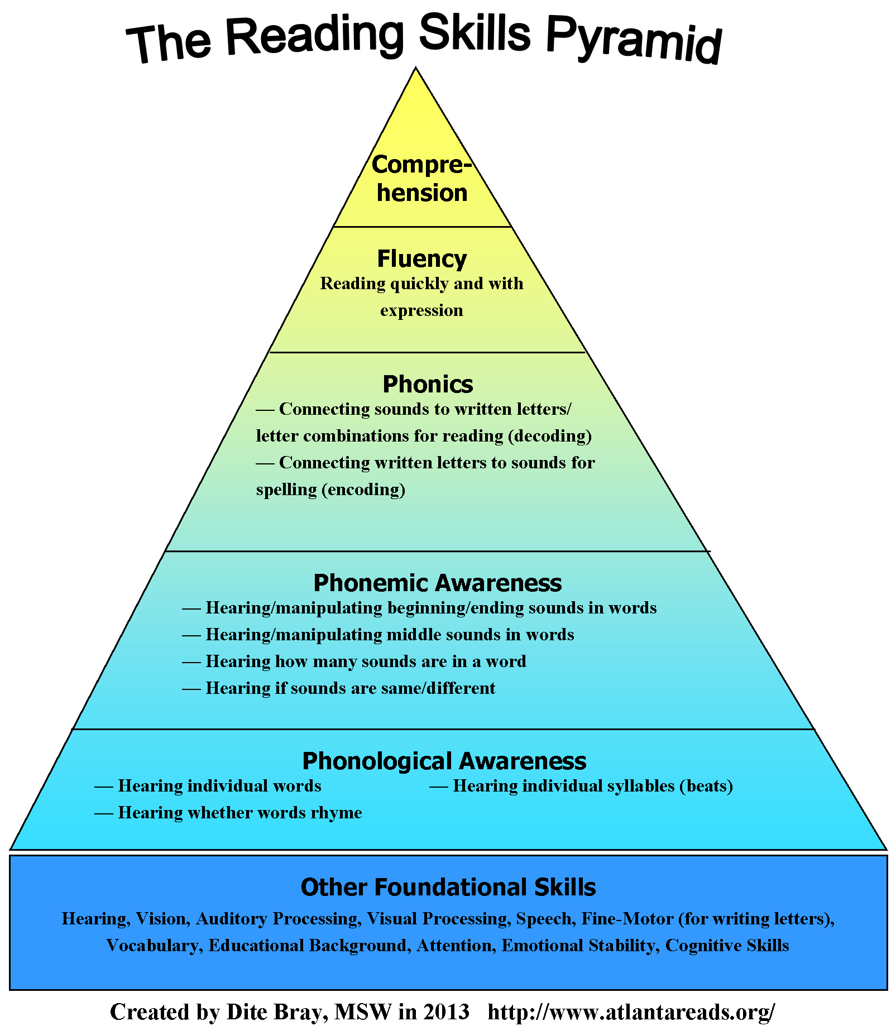

Slide 4
What is Phonics?
Phonics is a method for teaching reading where children learn letters by their sounds rather than their names.
Learning phonics helps children learn to read because instead of relying on memorising words by shape or guessing them based on picture clues or first letters, they can read new words by sounding them out and blending those sounds together.
Notes:
It is a method.

Slide 5
Why?
"The more that you read, the more things you will know, the more that you learn, the more places you'll go." Dr Seuss
"There is more treasure in books than in all the pirate’s loot on Treasure Island.” – Walt Disney
“There are many little ways to enlarge your world. Love of books is the best of all.” – Jacqueline Kennedy
Opens the world of learning!

Slide 6
How?
Lesley Clarke's Synthetic Phonics
Taught in Phases (Reception Phase 2-4)
The key for your child is to be able to recognise which sounds (phonemes) go with which individual letters and letter combinations (graphemes), and to begin understanding spelling rules.
Through song, actions, visuals, group work, independent activities and continuous provision.
Handwriting and phonics are completely separate things, so at the beginning of the term the children may not know how to write the letters because they don’t know them yet. Phonics is our first focus.
Rhymes Phase2WritingMatCurlyfA5LaSOrder.pdf
SingleLetterMnemonicsList.pdf
Notes:
From nursery/preschool to end of year 2 phases 1-6
Specific order helps them to build upon previous learning and consolidate and use learning.
Watch this video to explain terminology ad the basis of phonics.

Slide 7
Specifics...
What is Phonics? | The Phonics Nest saying the sounds.
https://thephonicsnest.co.uk/reception/ more specifics for Reception including blending
Jargon Busting

Slide 8
Have a think…
c | a | t
cat
back
chop
hair
high
night
sighting
thrash
Tale
extreme

Slide 9
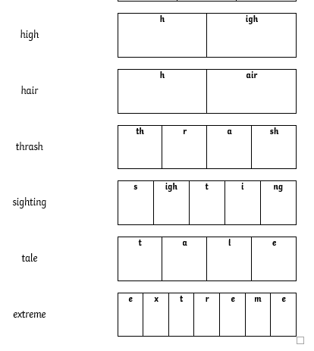
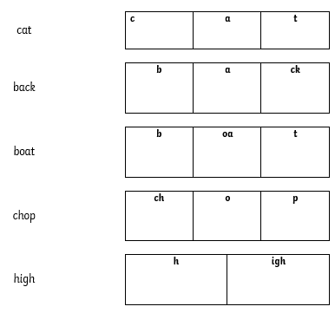

Slide 10
Tricky Words
A4Phase2TrickyWordWritingMat.pdf
Phase 3 Coloured Tricky Word Cards.pdf

Slide 11
Should all words be spelt correctly? What if they choose the wrong spelling choice for a sound?
It’s ok- having a go is the key in Reception. Try to avoid spelling it for them or letting them copy. Children at this stage will take a very long time to write, which is completely usual.
Phonetically plausible- as long as it can be read by another adult, regardless of spelling, it is ok and should be praised.
Building confidence- In Reception we want your children to be fearless. Having a go and trying is so important. Writing 5 words in a row for Reception children is tiring and hard work but they will build up and things become easier for them. A little bit done well, with concentration and a sense of pride, is more important and rewarding than lots of copied writing or feeling stressed out after needing to hurry or having struggled. Celebrate every little bit. If they can only think of one letter, well done! If they can hear and write the last letter, well done! If they can do one word, well done! And so on.
Notes:
They need to try
Need to listen
Have a go
Rules/patterns and further understanding will come later.
Important that they are encouraged to use blending method for reading as it helps with spelling- otherwise can’t spell. \reading out loud is so important

Slide 12
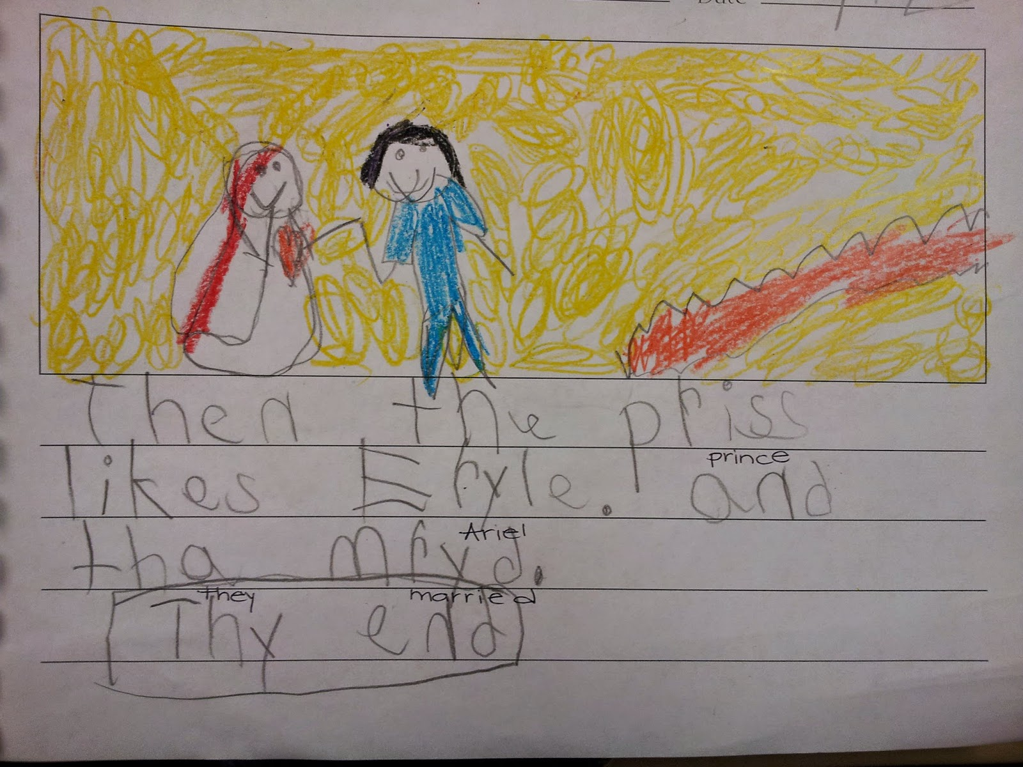
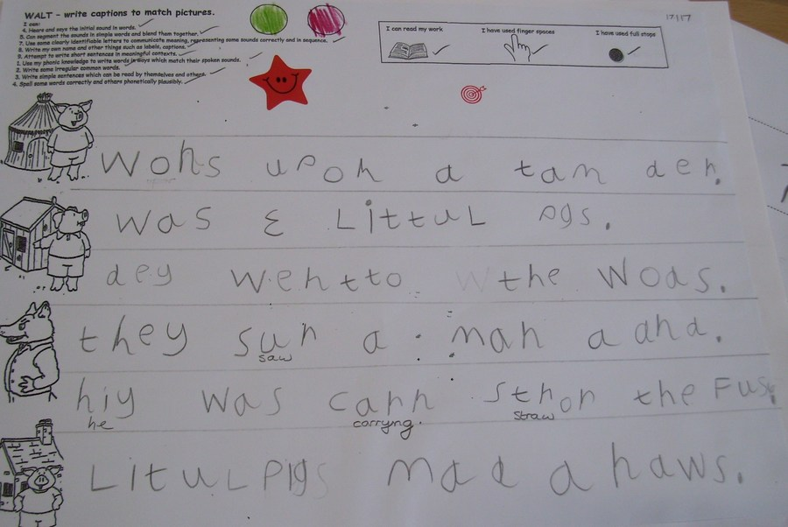

Slide 13
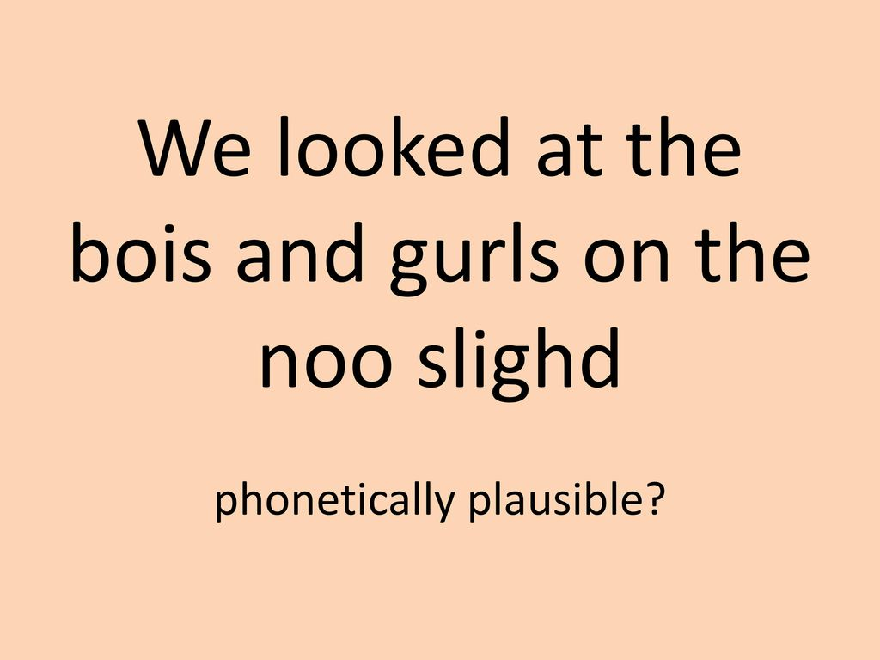
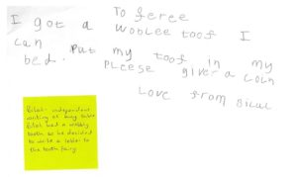

Slide 14
Reading Books
Reading at home
Keep books in book bag everyday.
Decodable texts
Revision text
Notes:
Wordless books, what’s the point? Oracy, retelling, imagination, comprehension, bookcare, questioning, vocabulary, story structure, phonological awareness.

Slide 15
How can you support?
Talk- talk lots and lots to your children, Encourage correct pronunciation of words and talk in sentences. This all aids the children when it comes to writing. If they can hear the sounds, they can often begin to write them. We will pick up any issues regarding speech or hearing and help to support.
Play games- what does that start with? What sound comes next? Etc. We will be popping out game ideas throughout the year.
Read to different people, call up/facetime a relative and read the book.
Encourage reading and modelling reading. If they can see you doing it, they will want to also. Even picture reading is important.
Use the rhymes and models we use in school.
These are some useful websites:
https://www.facebook.com/profile.php?id=100057289546942&sk=videos
https://www.facebook.com/phonicsfamily
https://www.theschoolrun.com/boost-phonics-confidence
https://www.phonicsplay.co.uk/
https://www.bbc.co.uk/cbeebies/grownups/the-alphablocks-guide-to-phonics
https://www.oxfordowl.co.uk/for-home/reading/phonics-made-easy
https://thephonicsnest.co.uk/?fbclid=IwAR2nohFxtBRdKjcJC6OkPRVN5uvIFaWI5UBMi6_L2hlZ75aAs80ueYb_o4s
Ask if you are unsure, but we will guide you all the way.
Resources available on Reception Class Page on Website.
Notes:
Learning, modelling sound teacher say. Using the video.

Slide 16
Key Take Aways
Use letter sounds not names at this point.
Use pure sounds SSS-U- NNN rather than Suh- U- Nuh
We don’t start alphabetically
Use lower case letters when writing and only do a capital for names at this point
Read, read, read

Slide 17
"Reading for pleasure isn't separate from learning to read."
Pam Allyn

